Slide 1


Slide 2


Slide 3
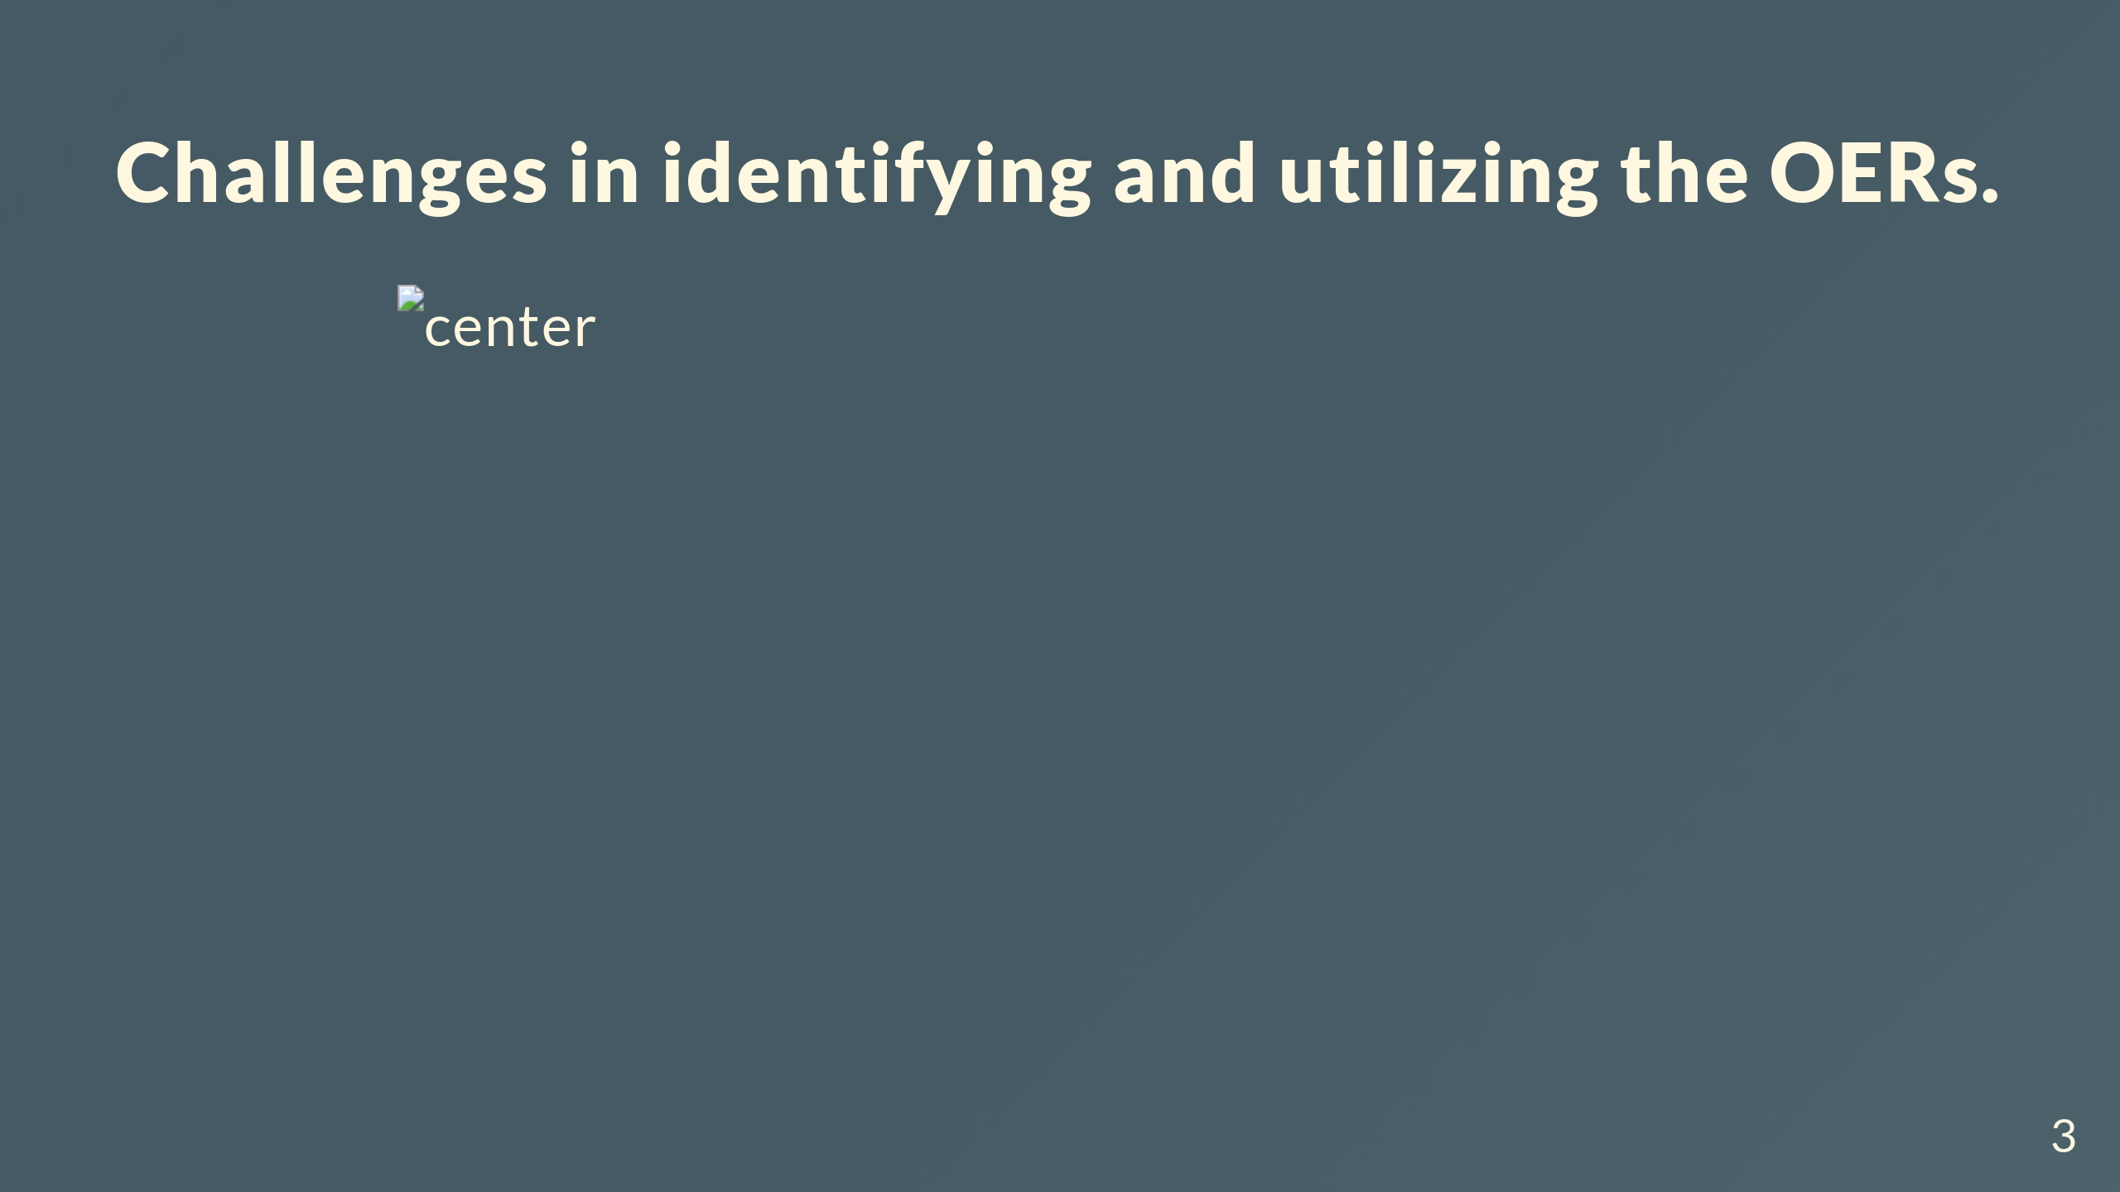
Notes:
Presenter notes There is inadequate perception among teacher educators on availability and usability of relevant OER for teaching the contents. Teacher Educators are varied on their perception regarding OER as relevant and active support to teach content. 18% of teacher educators perceived the OER as need of the hour while 13.88% perceived OER as not supportive. 68% perceived with neutrality. 82% of teacher educators are skeptic on authenticity of available online resources including OER materials.

Slide 4
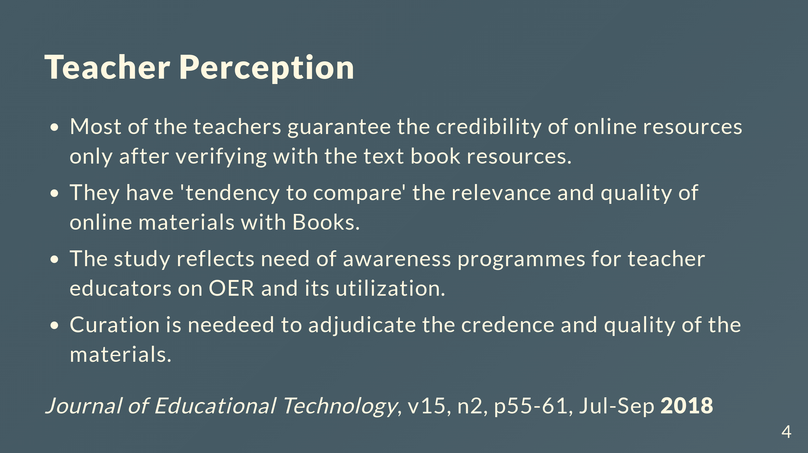

Slide 5
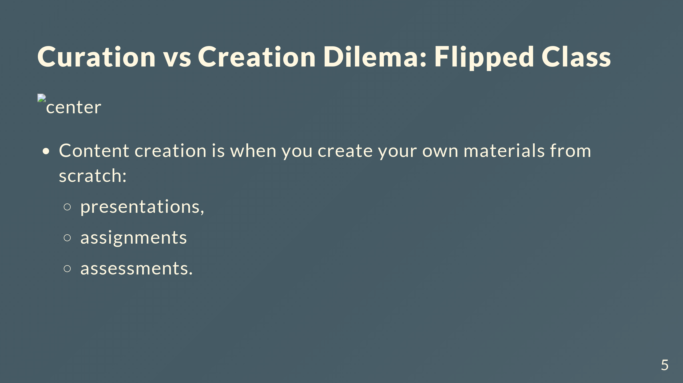
Notes:
- You mostly likely already engage in a mix of content creation and content curation. - Content creation is when you create your own materials from scratch—from syllabi, presentations, assignments and assessments. - You realize that you’re a one-stop shop education machine!. - You don’t write your own new course materials every semester. - Instead, you think about the use of existing content where it suits your needs.

Slide 6
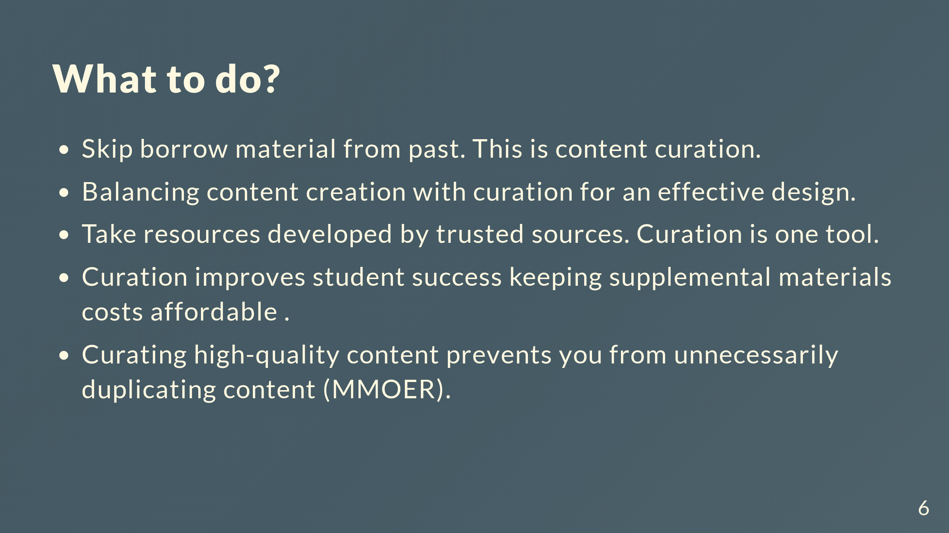

Slide 7
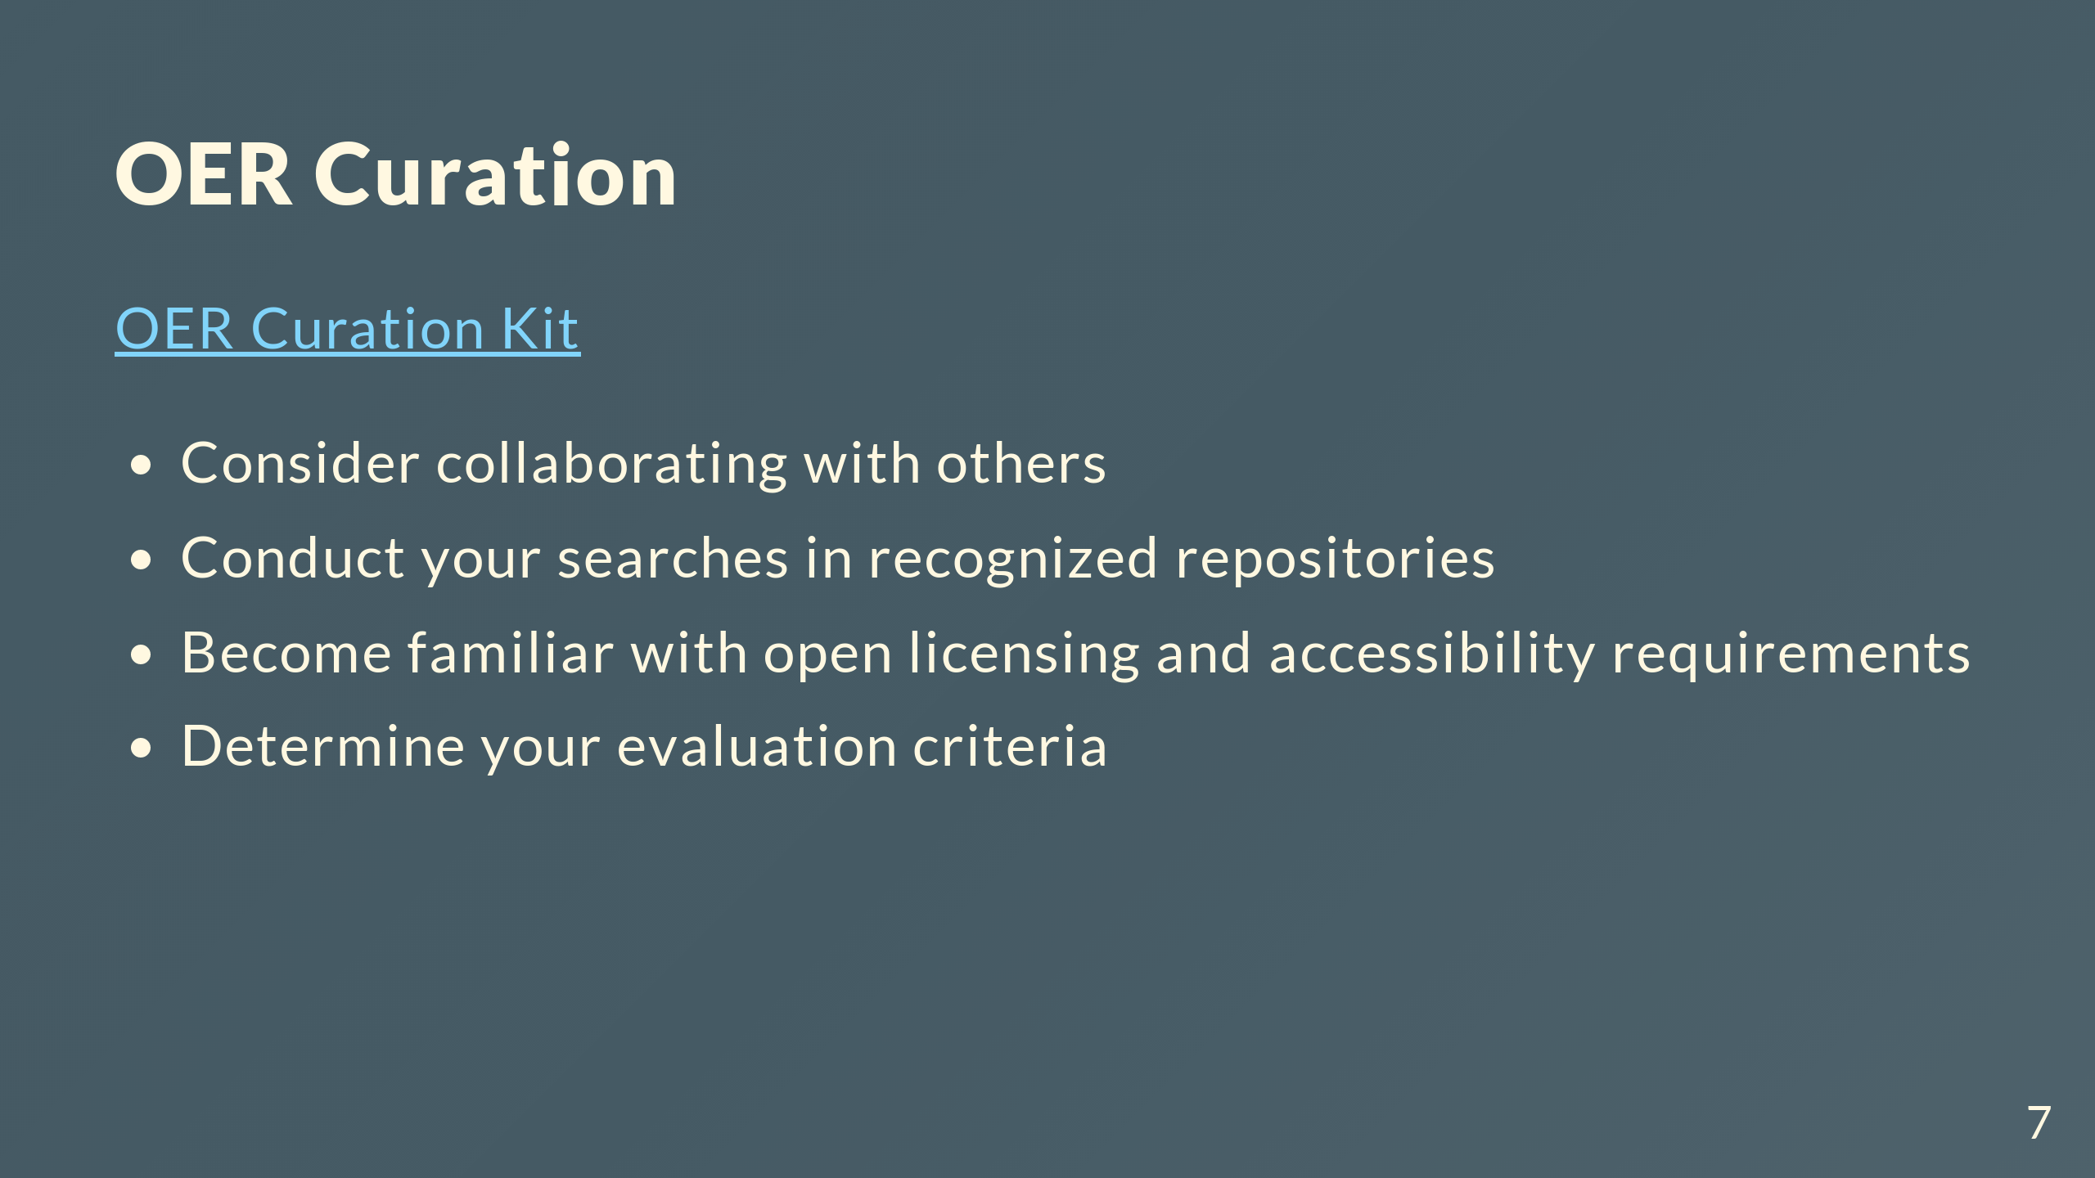
Notes:
Contents: [About OER]

Slide 8
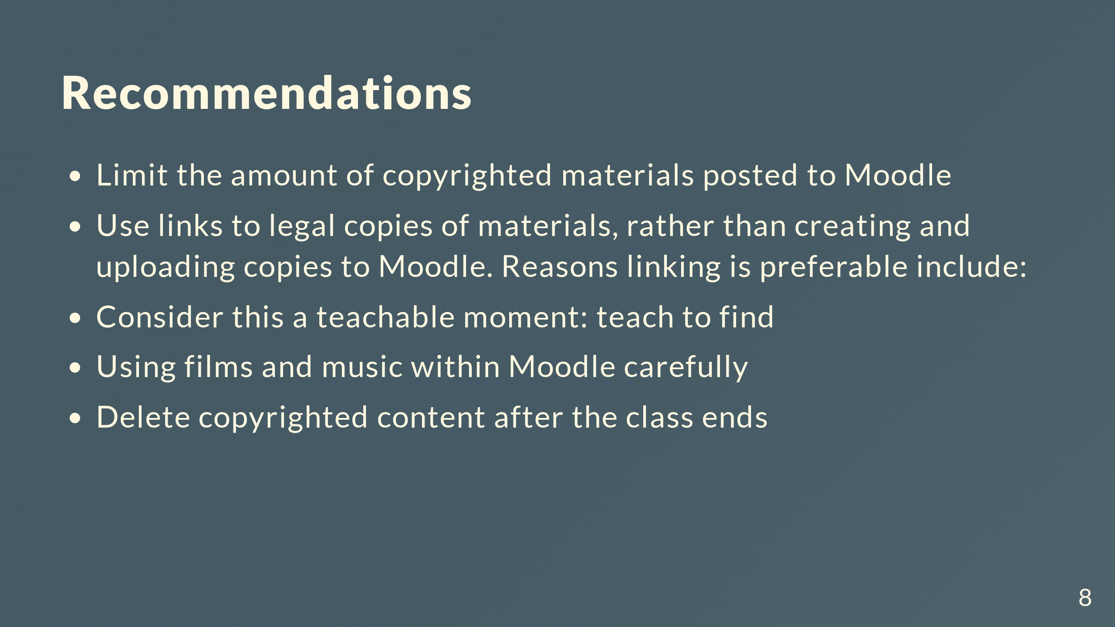

Slide 9


Slide 10
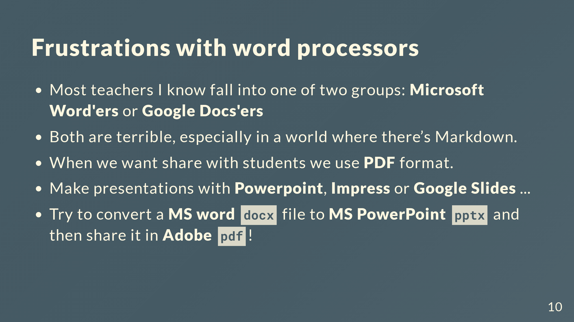

Slide 11


Slide 12
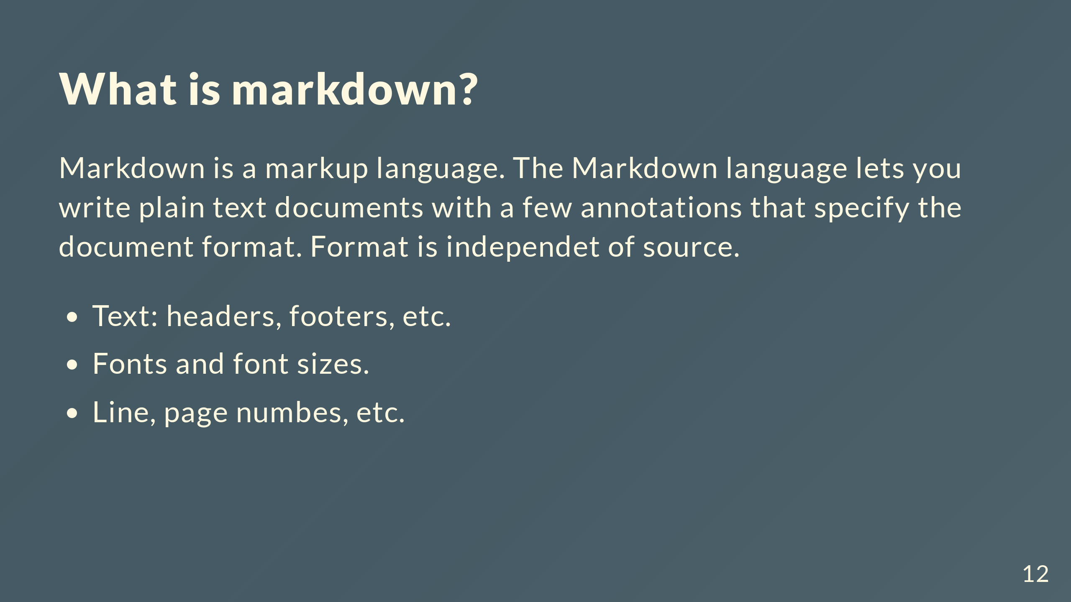

Slide 13
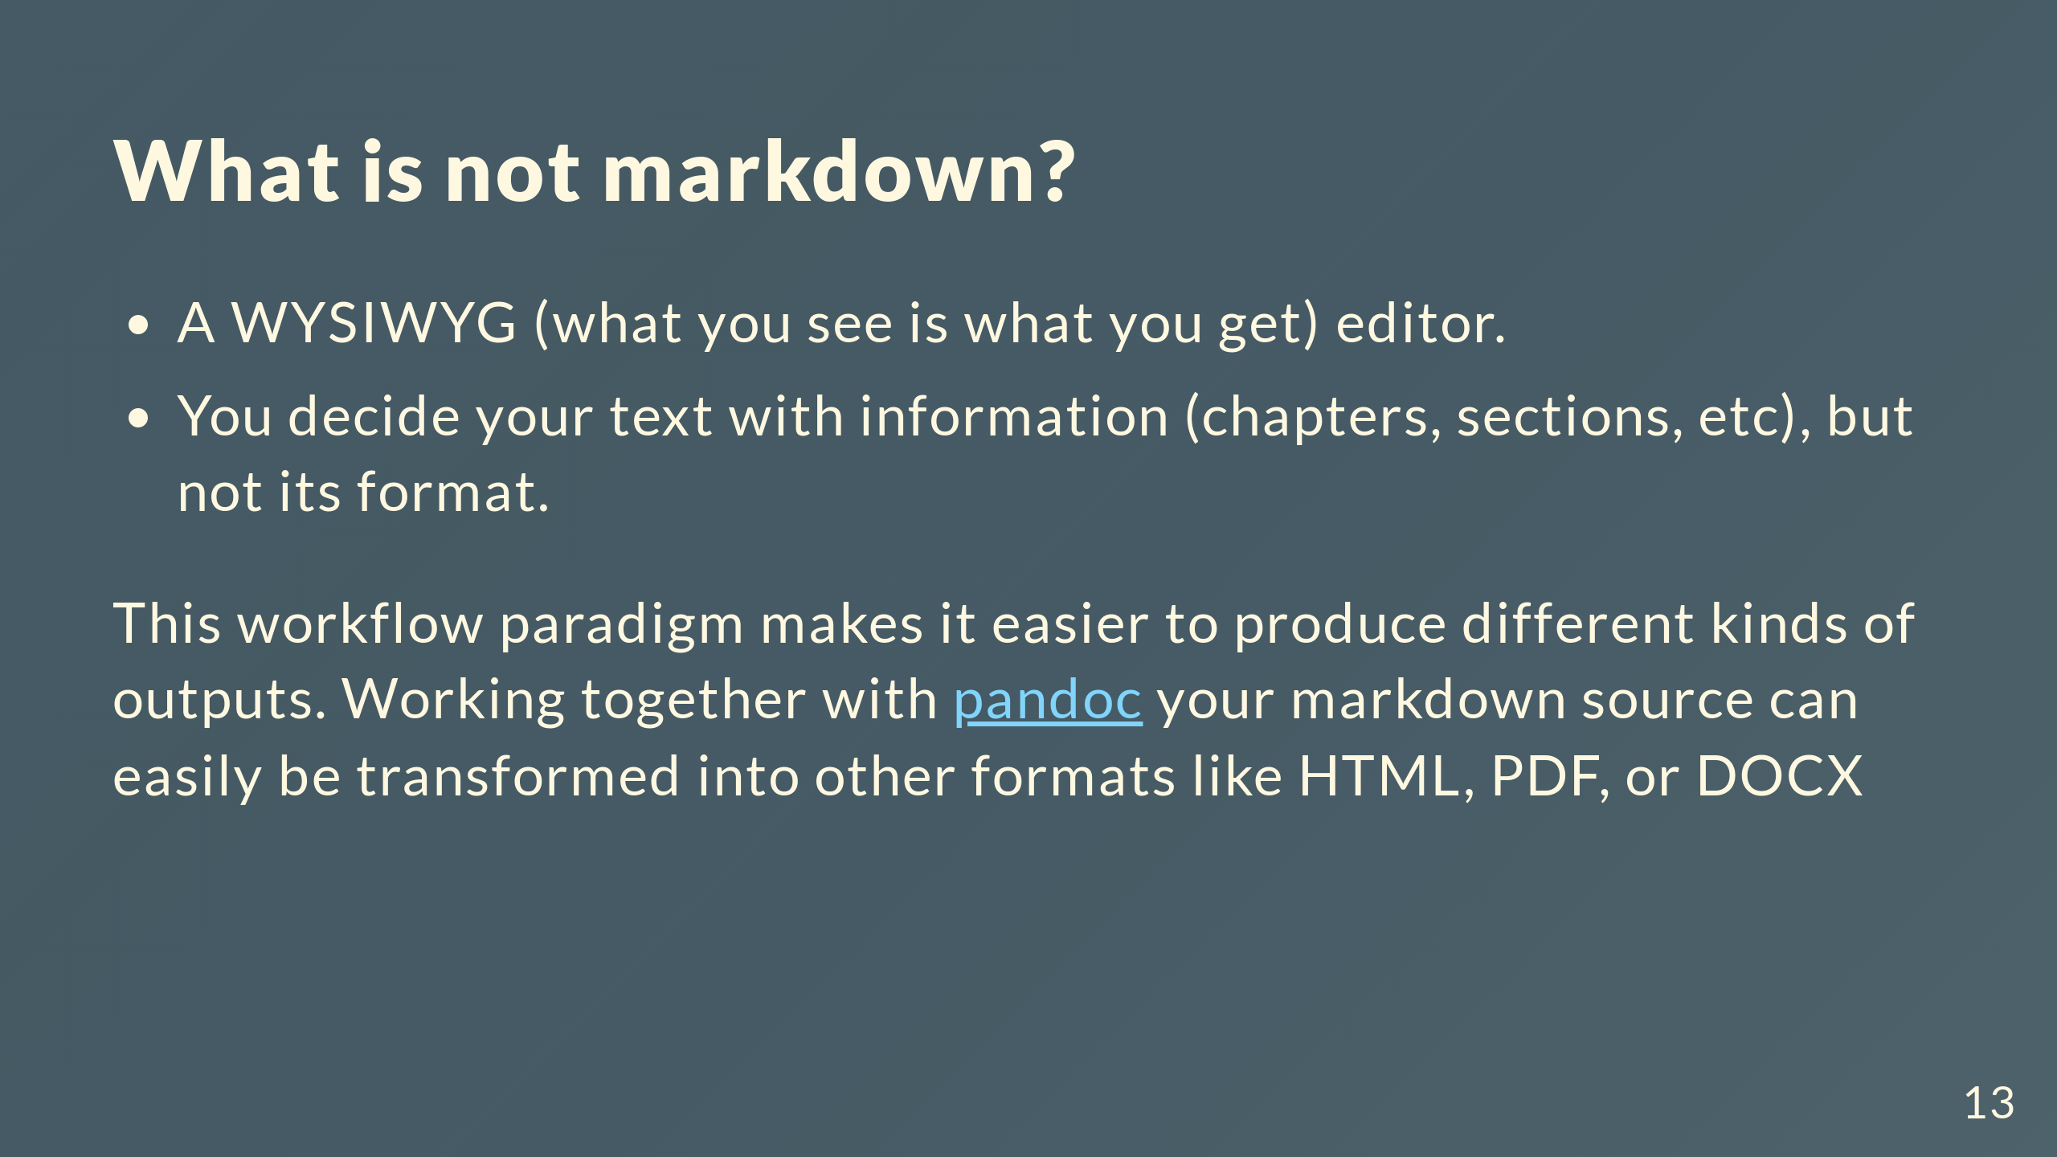

Slide 14
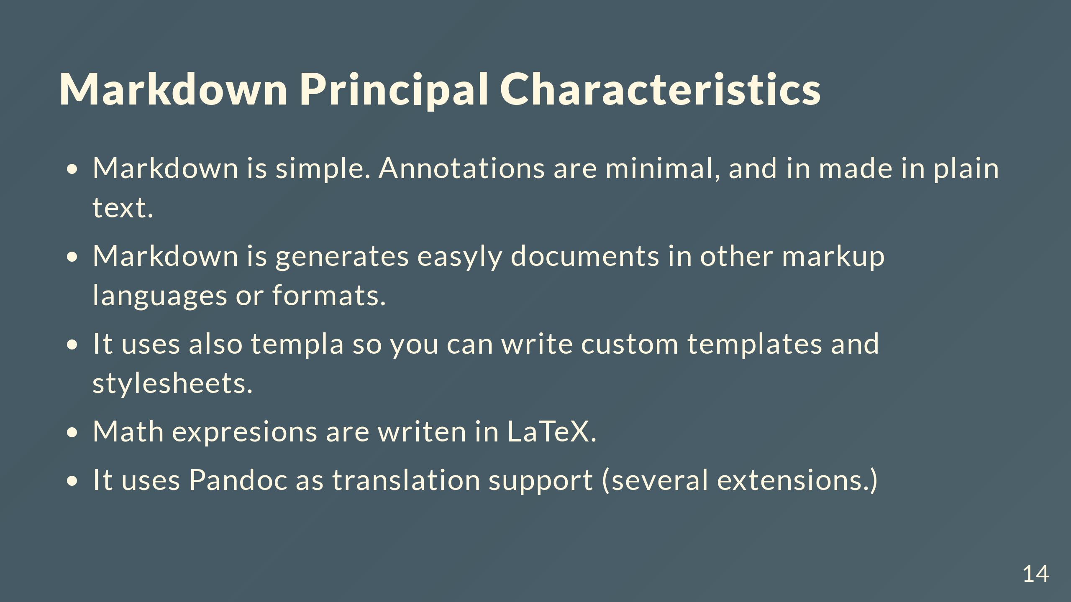

Slide 15
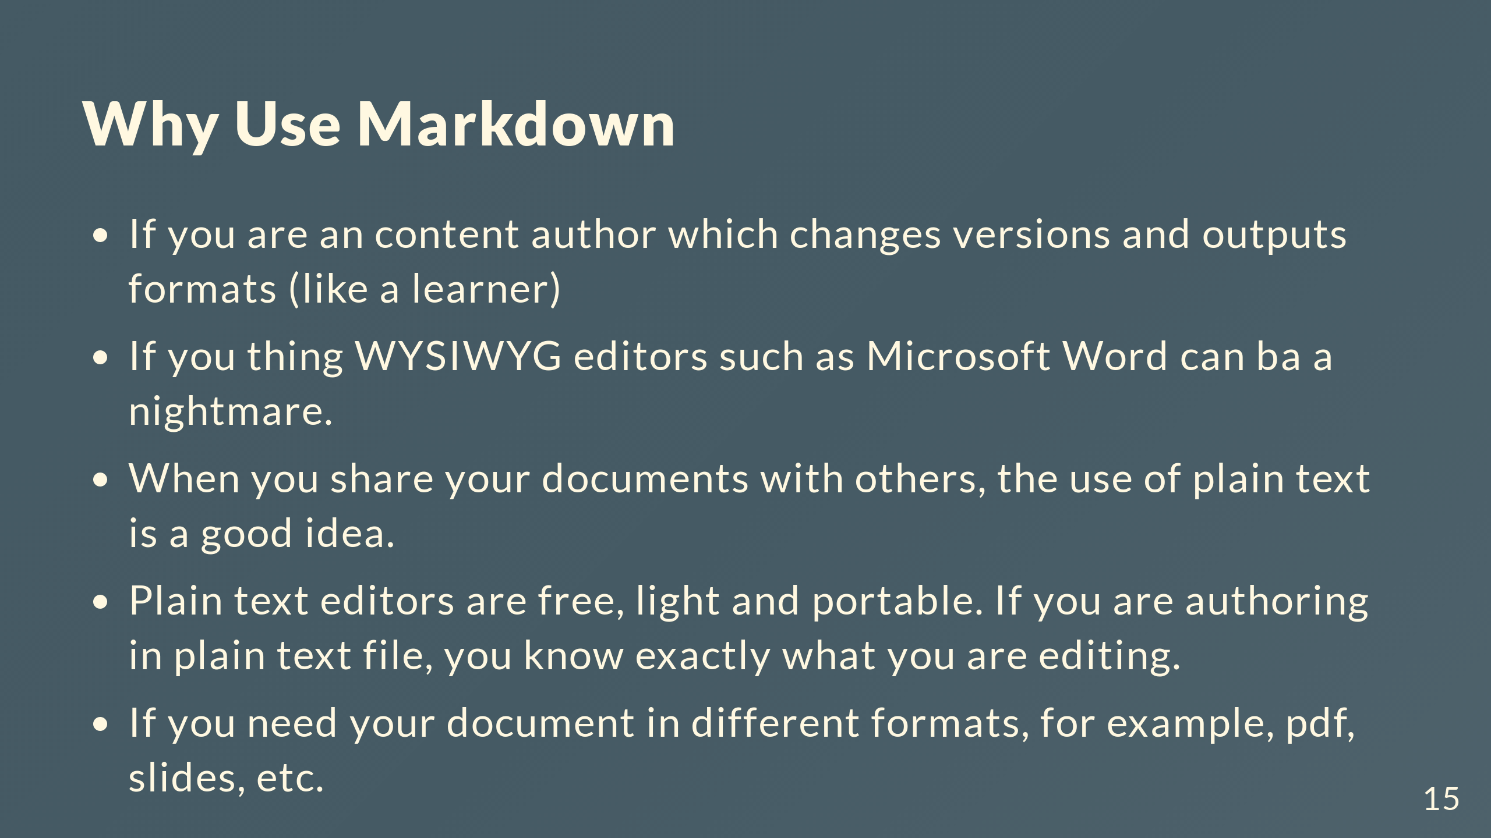

Slide 16
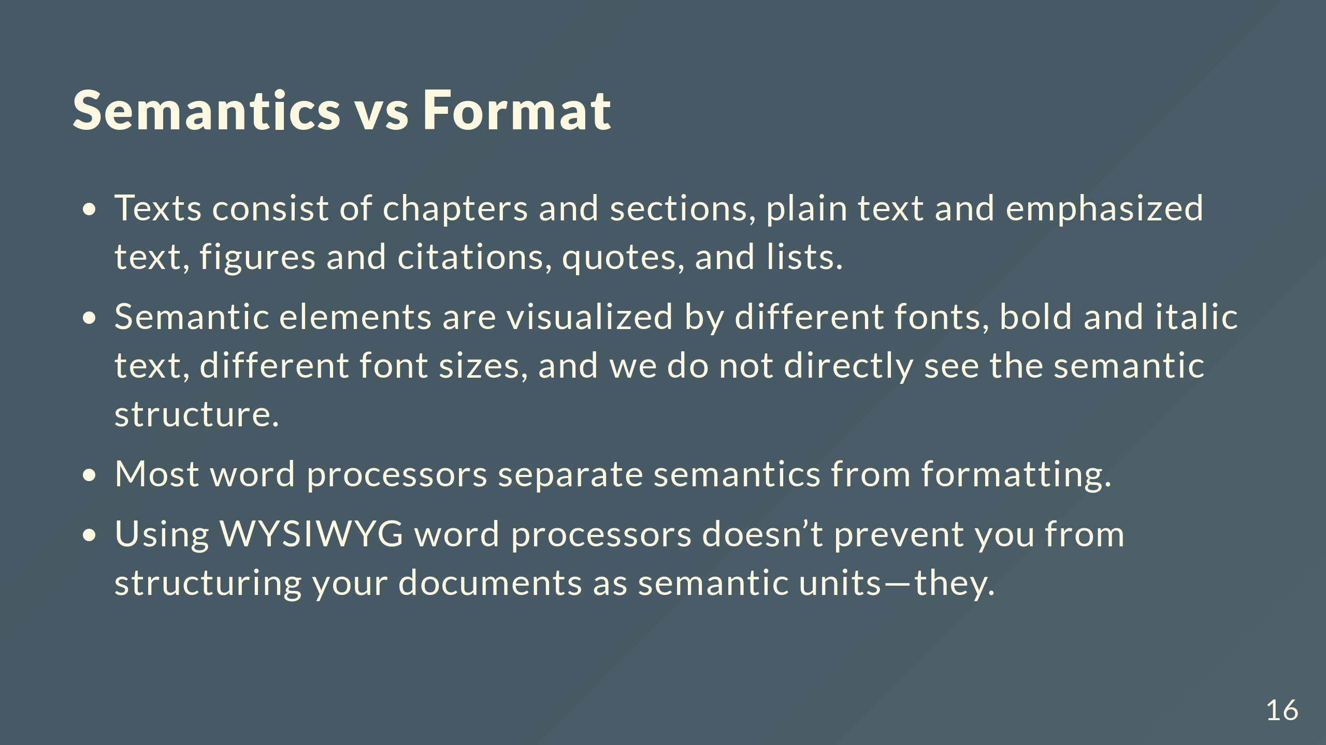

Slide 17
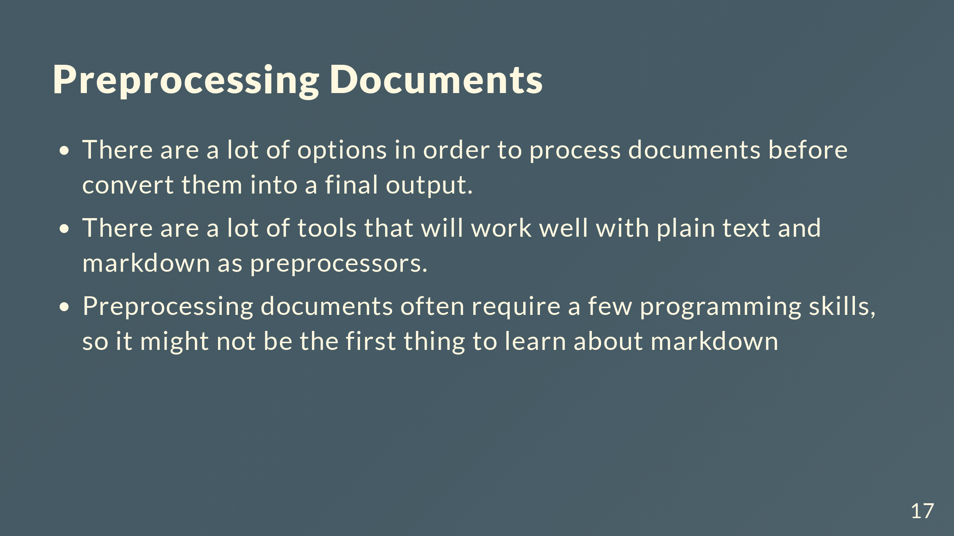

Slide 18
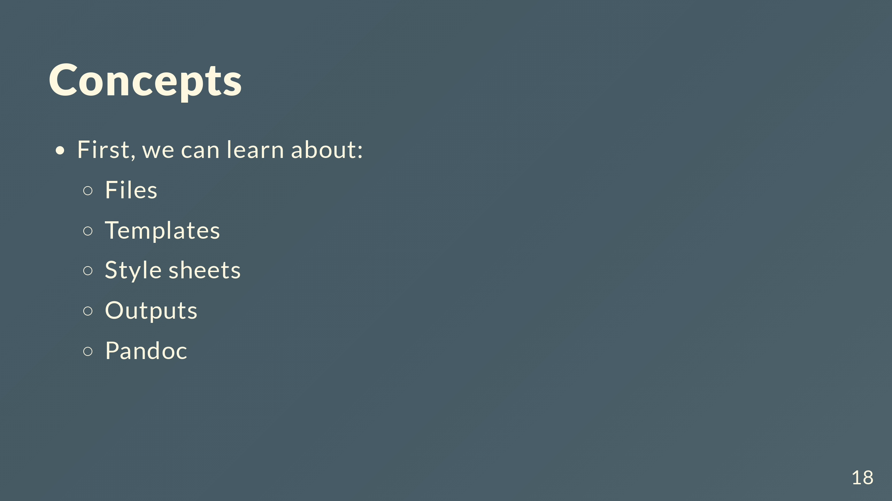

Slide 19
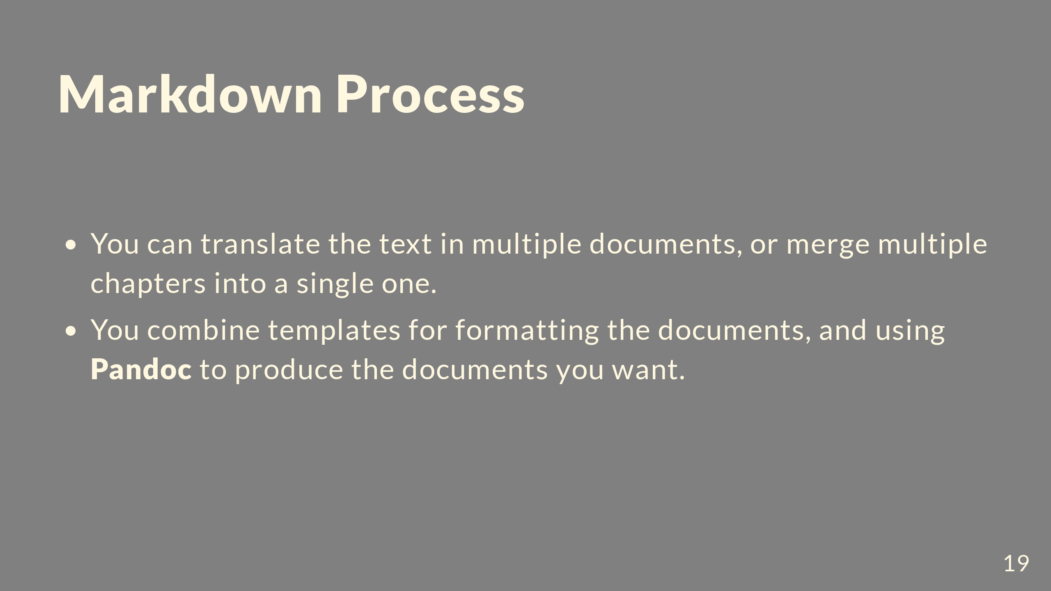

Slide 20
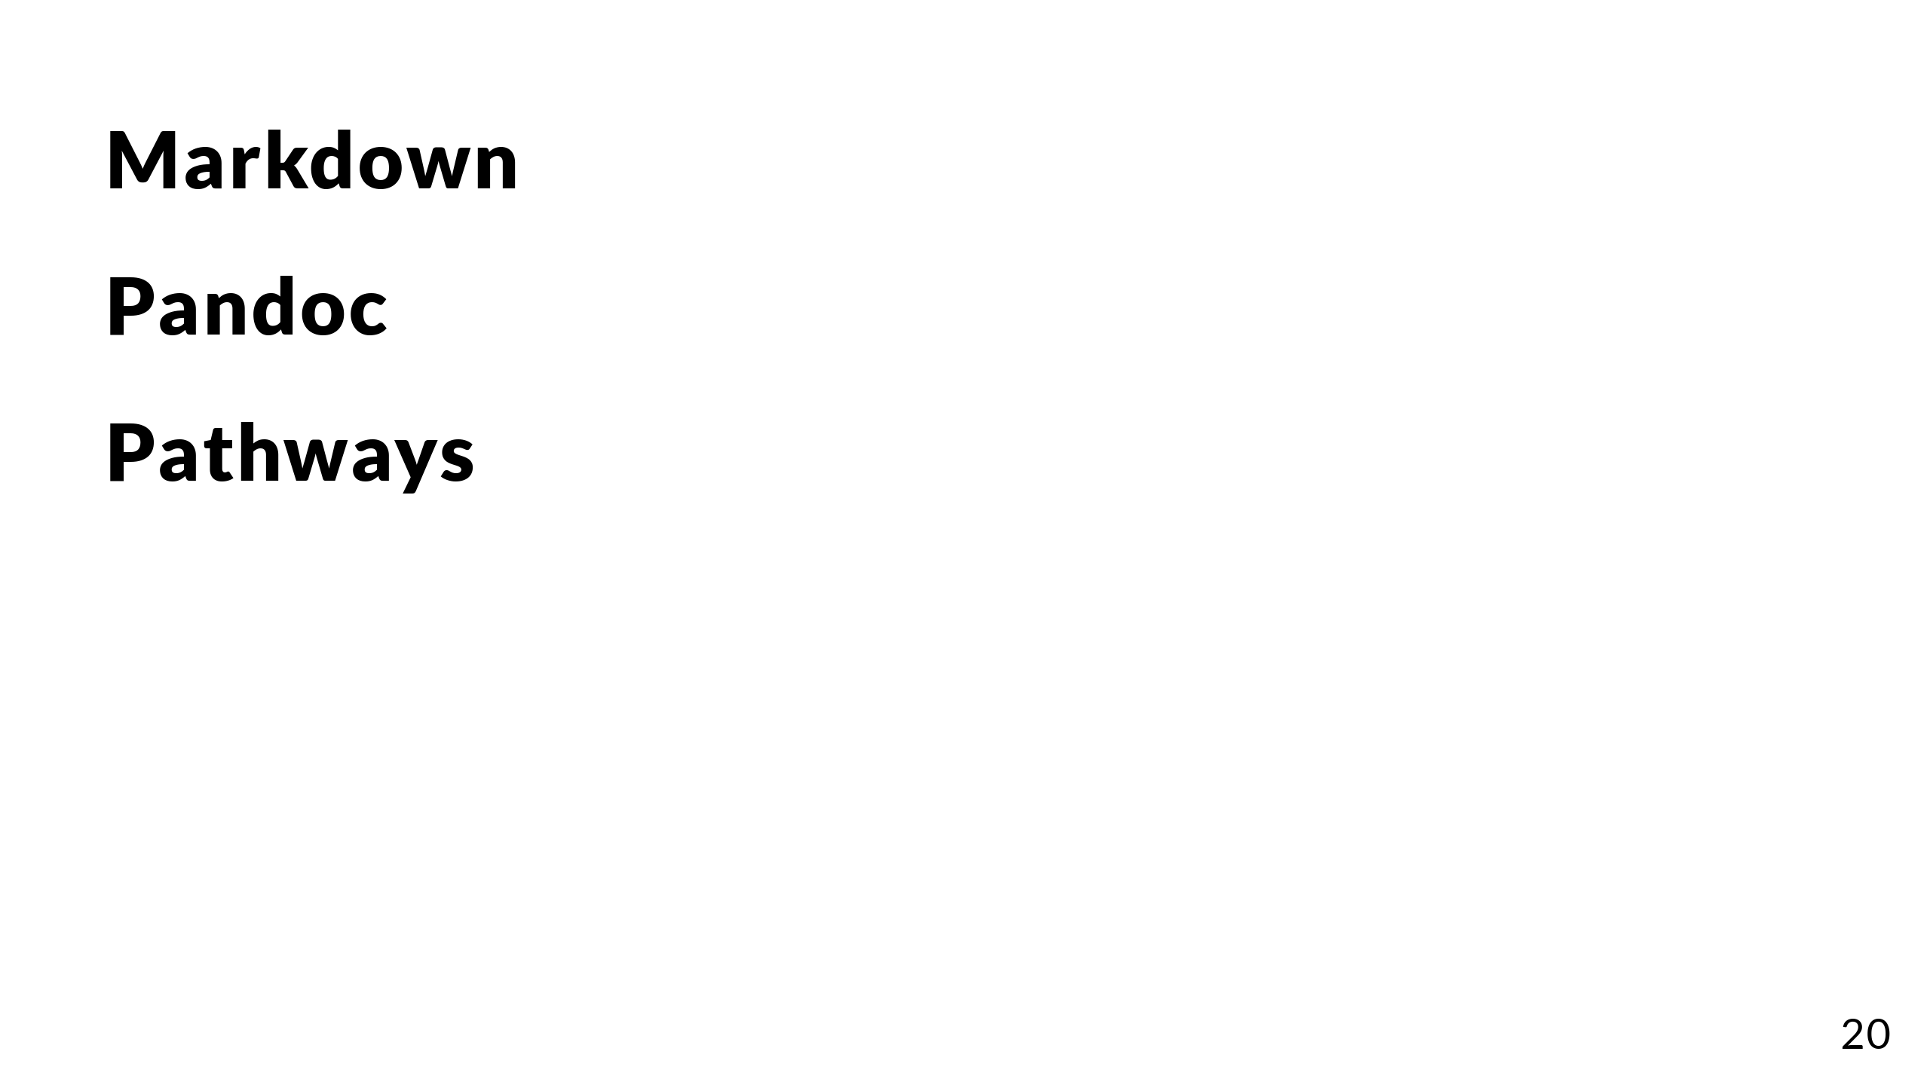

Slide 21
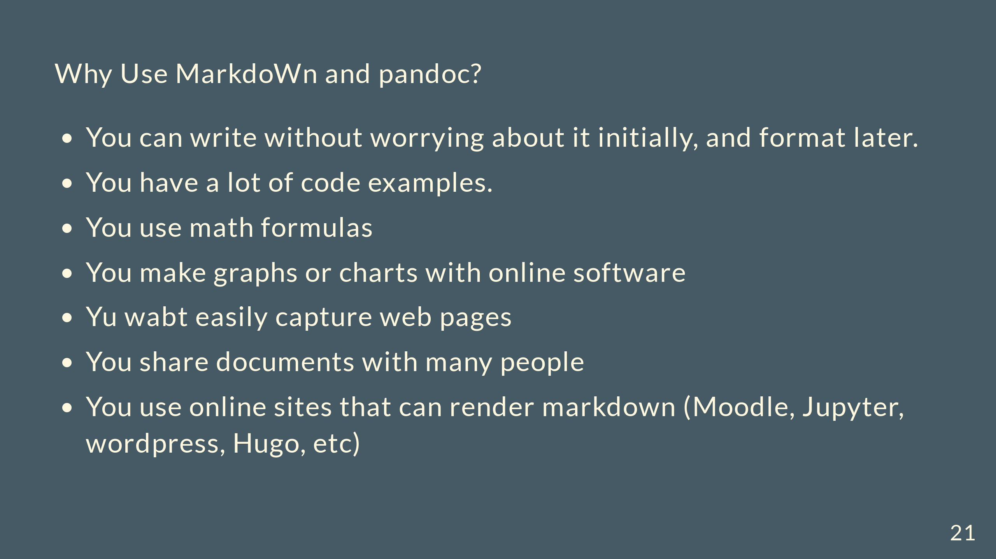

Slide 22
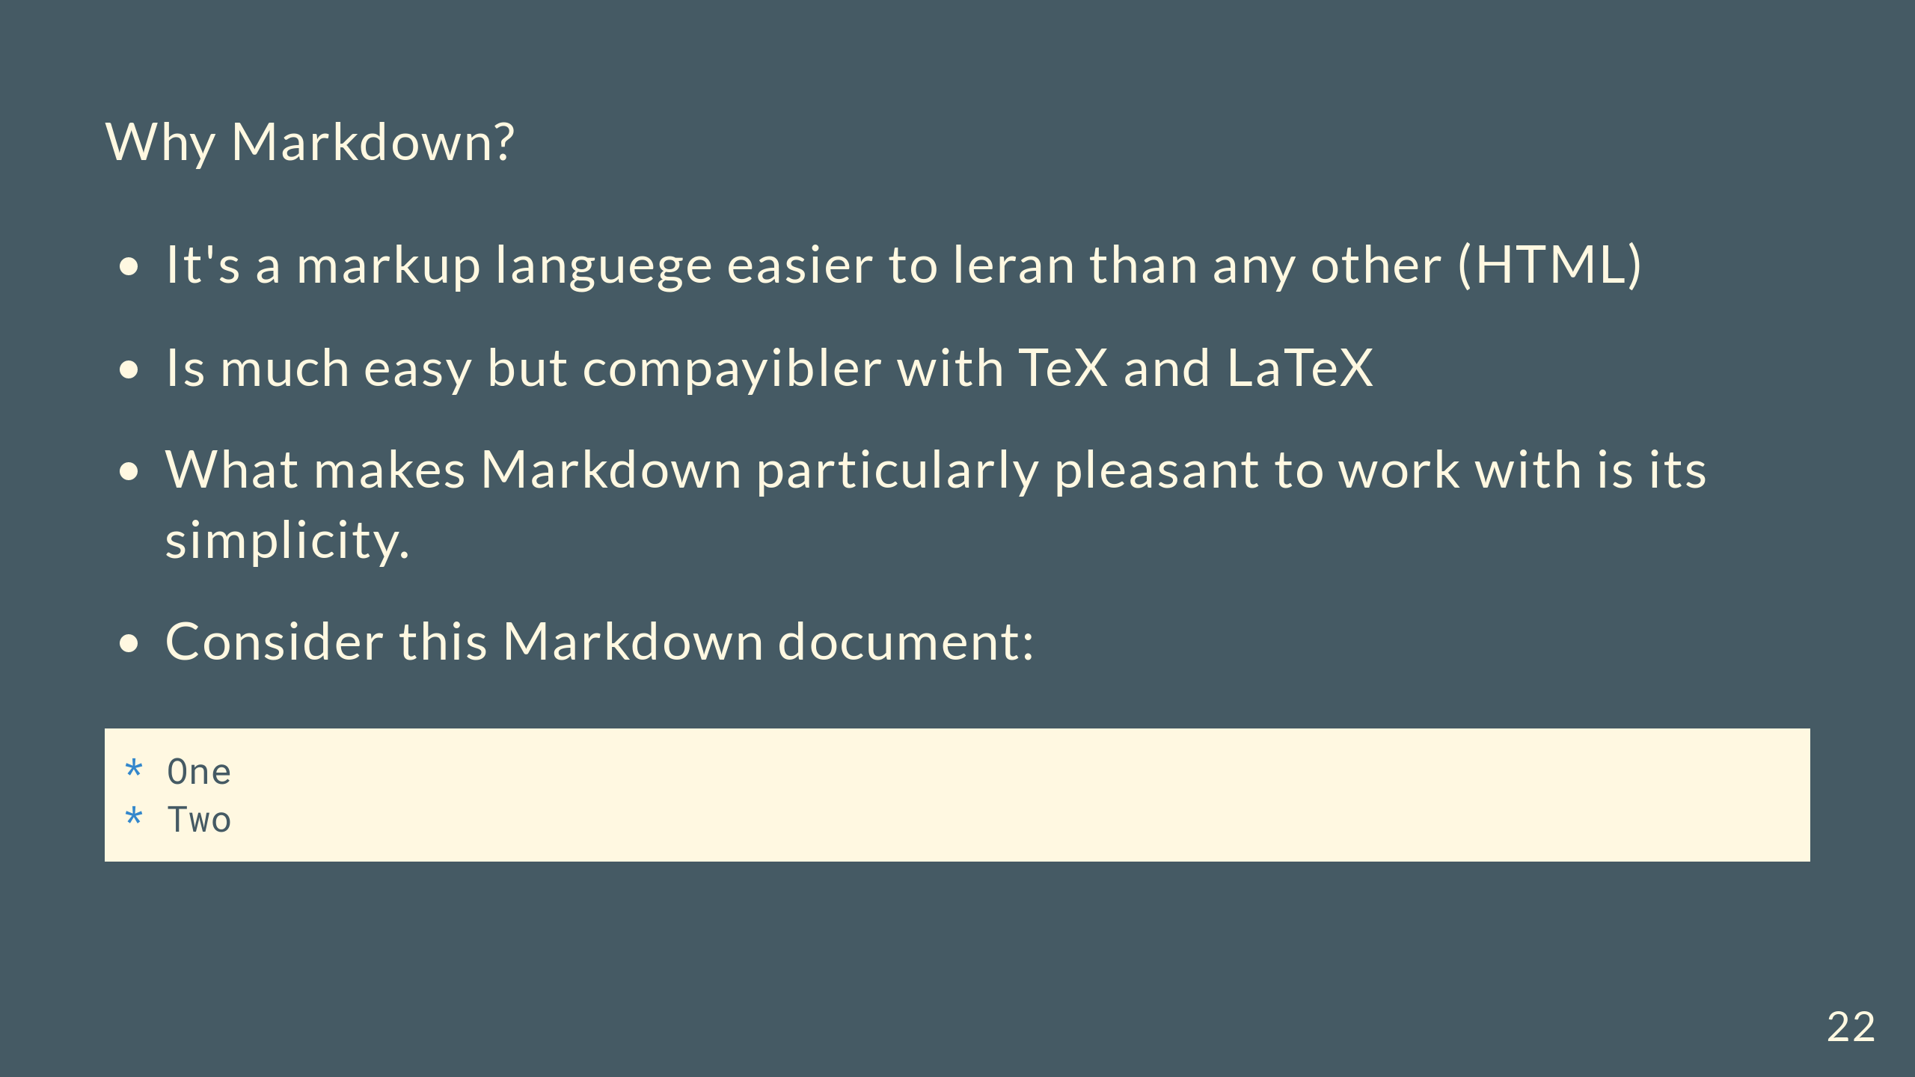

Slide 23


Slide 24
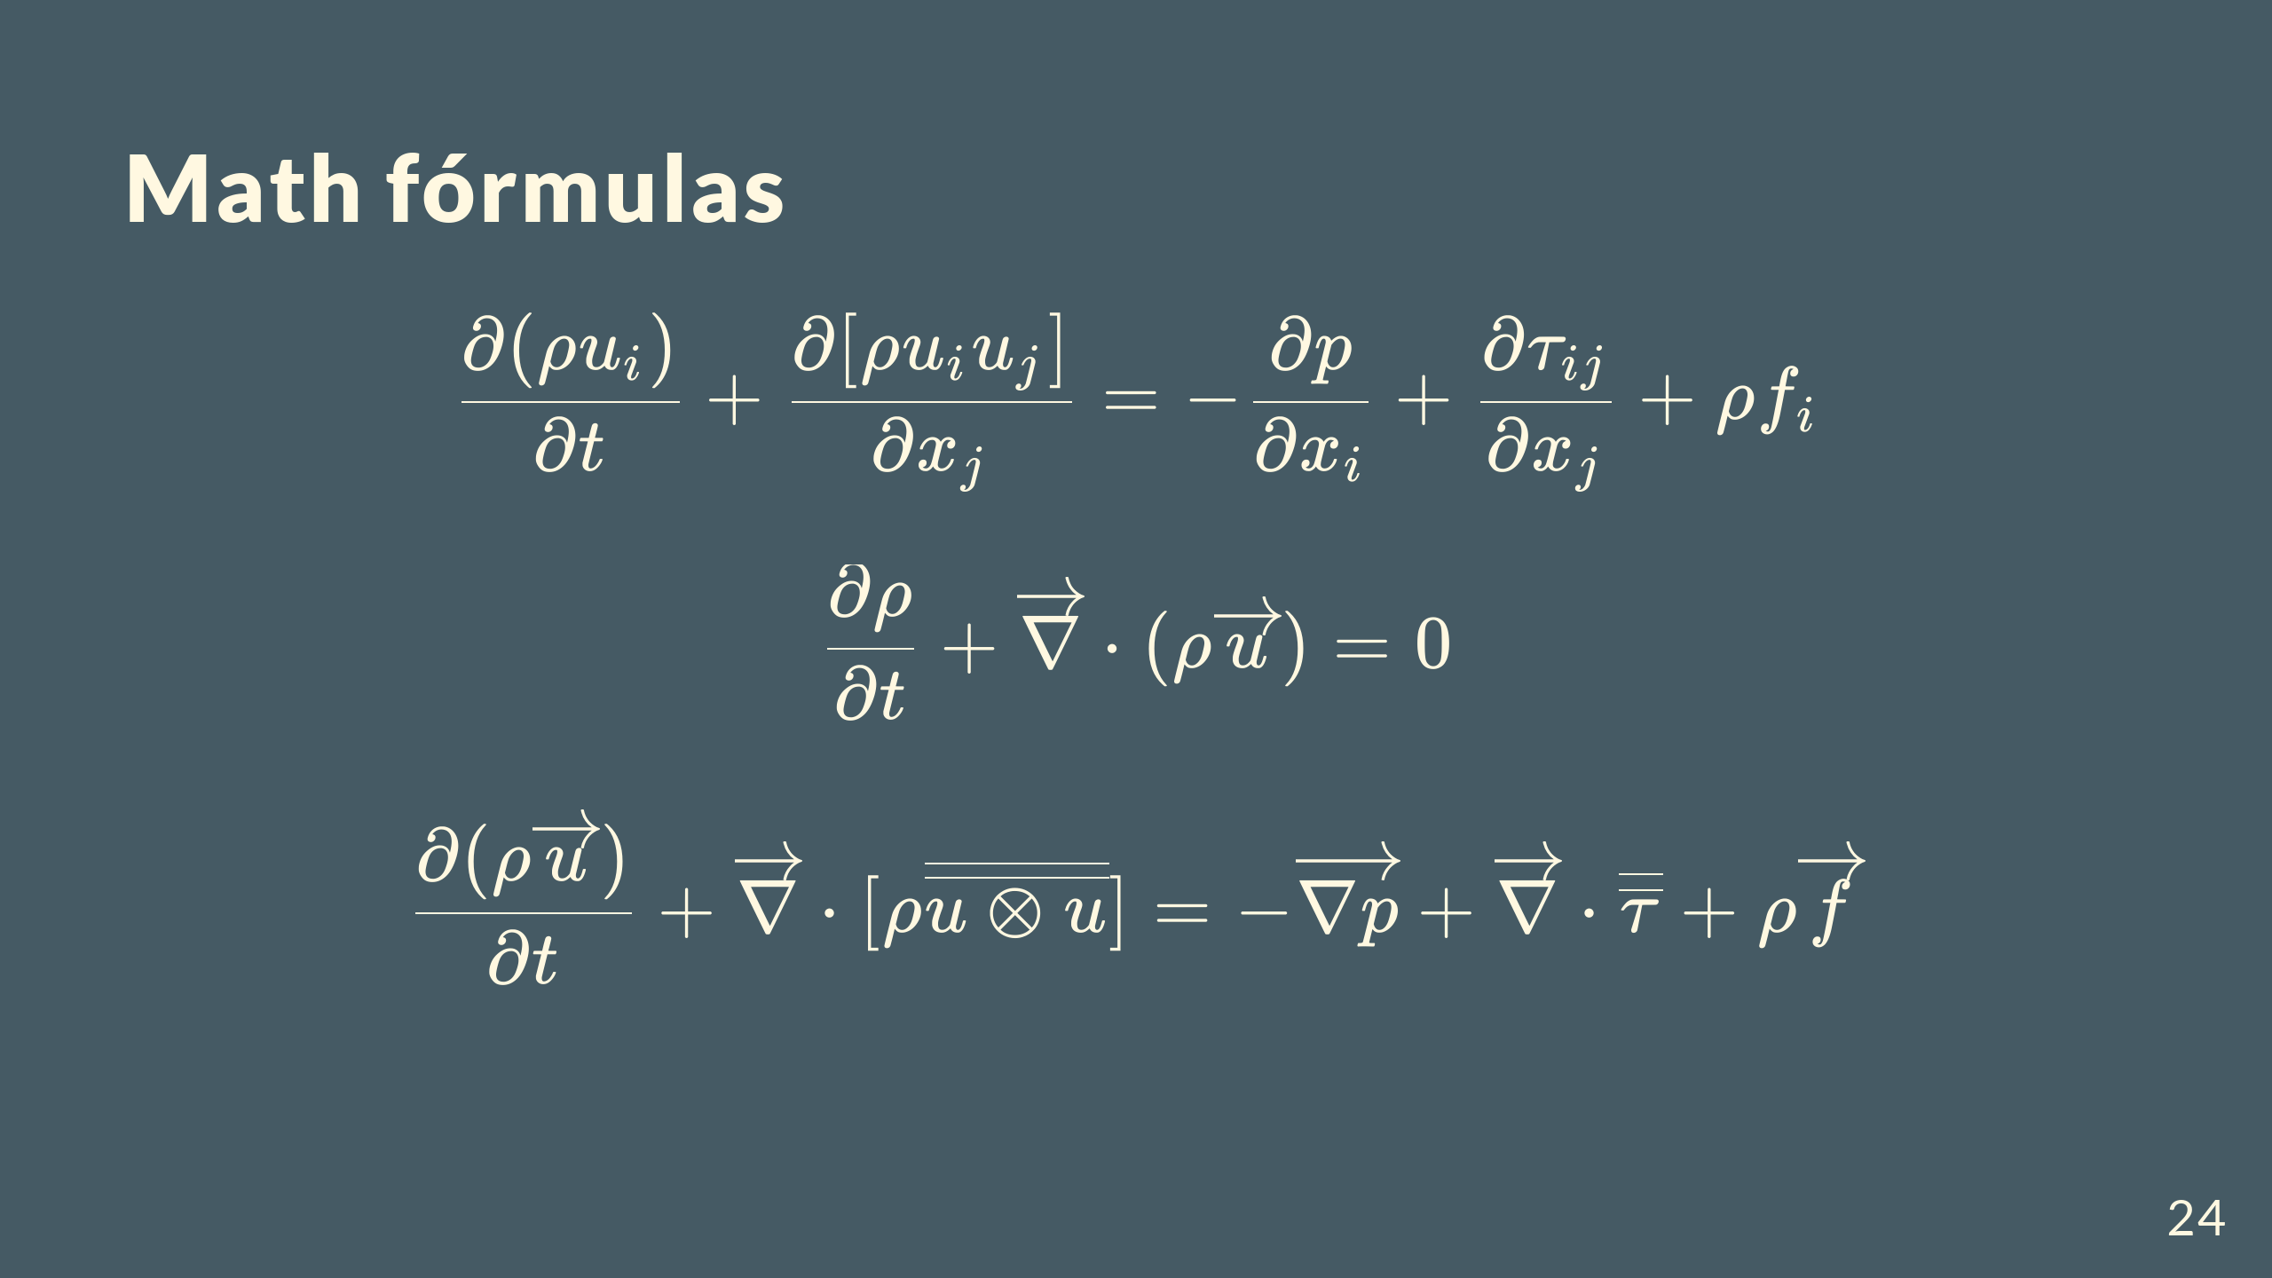

Slide 25
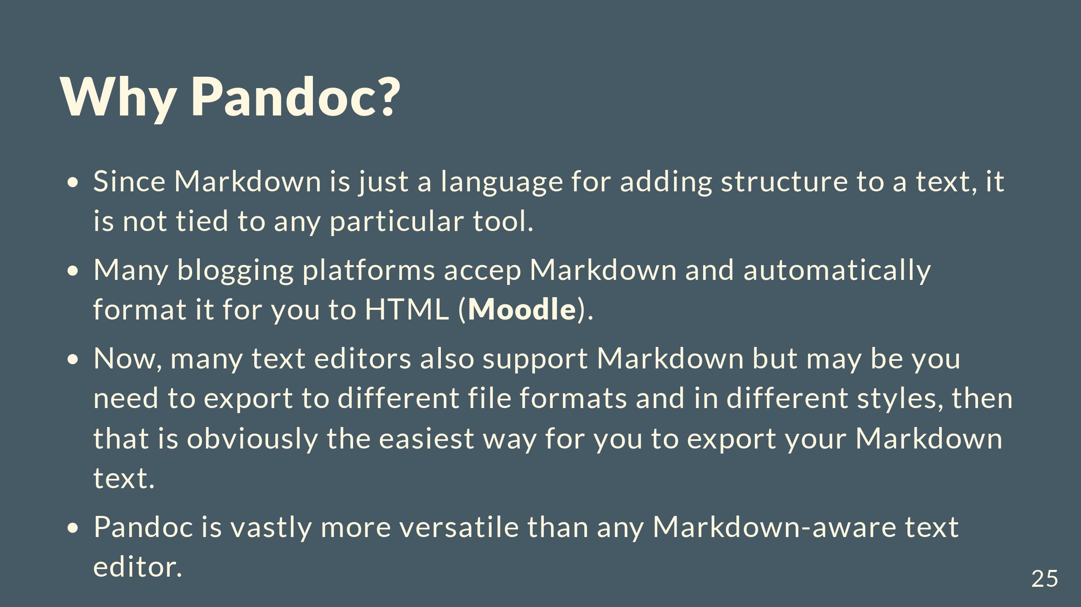

Slide 26
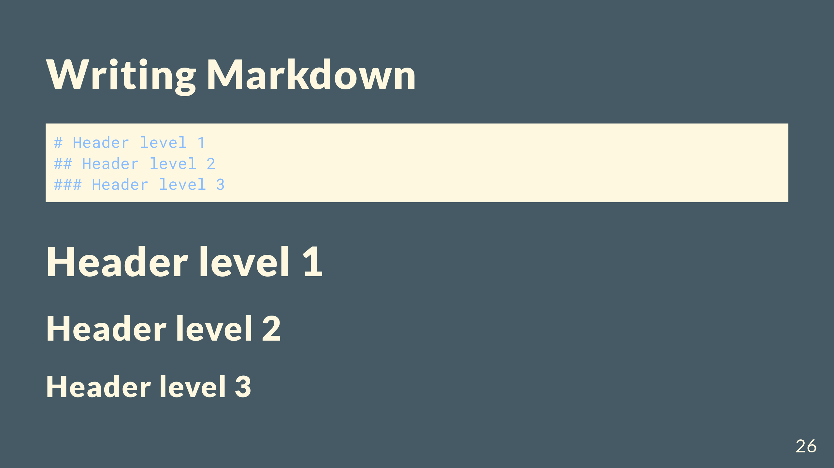

Slide 27


Slide 28


Slide 29
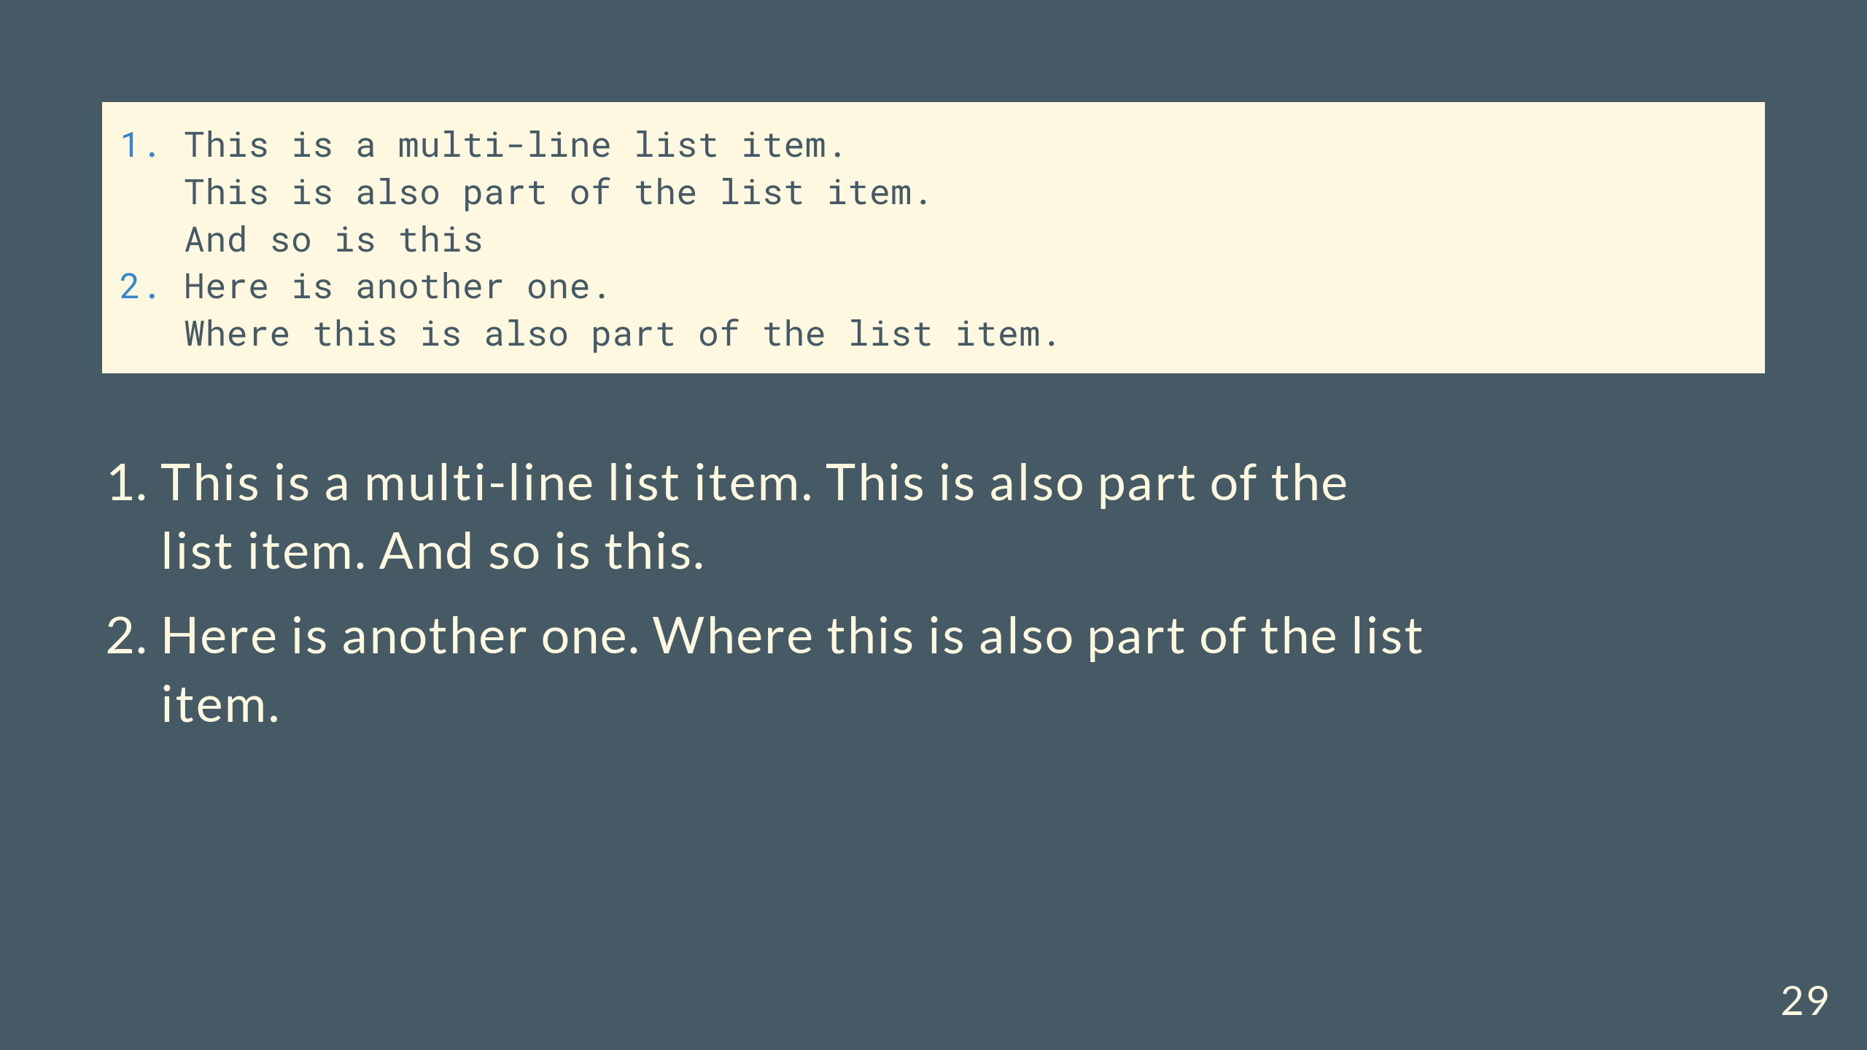

Slide 30
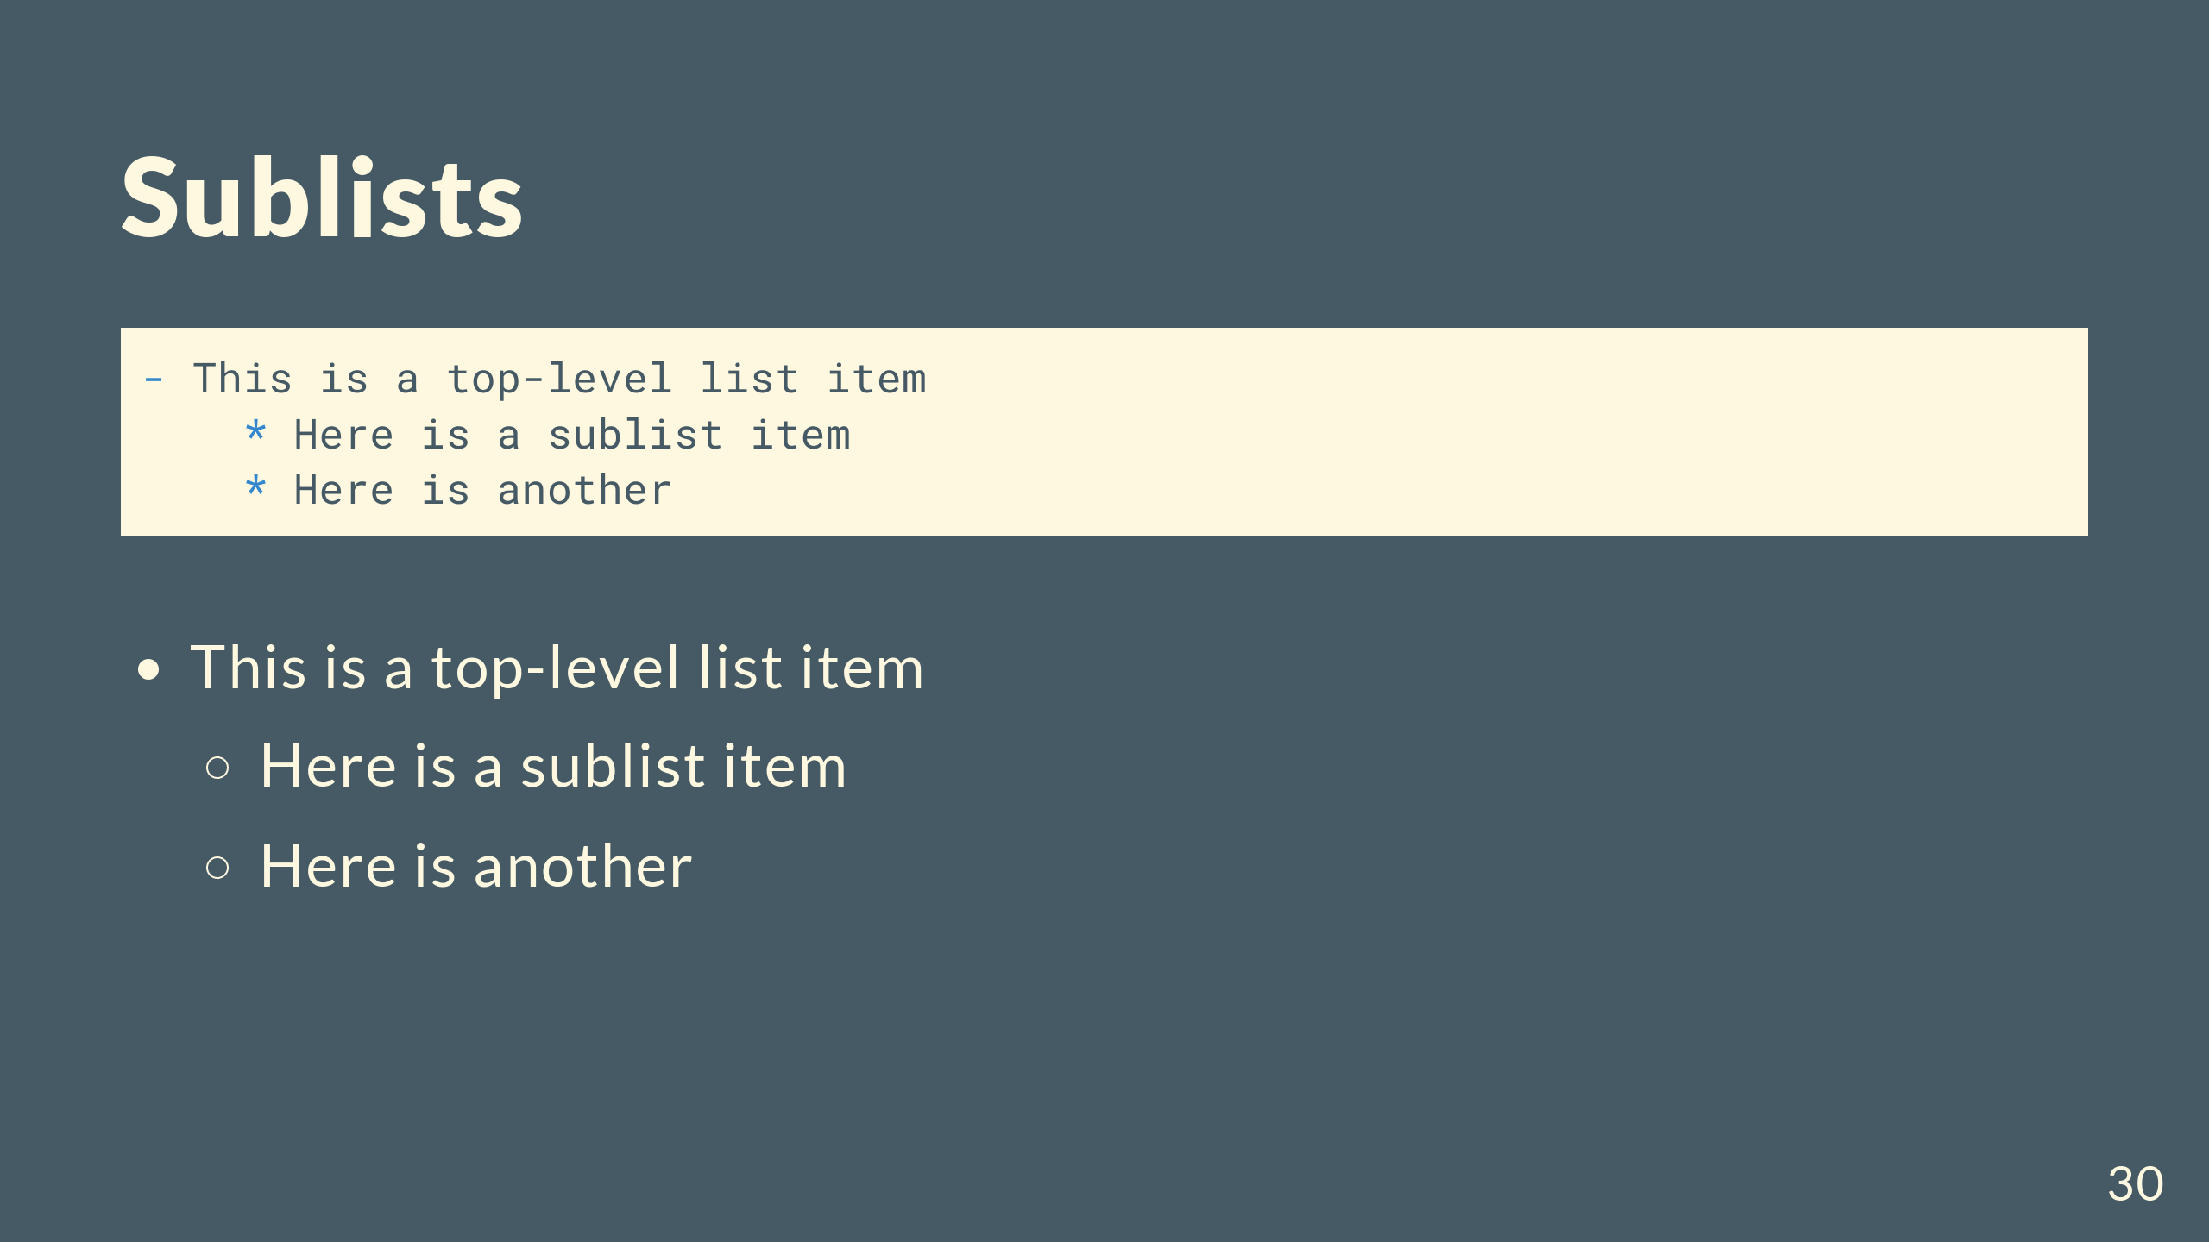

Slide 31
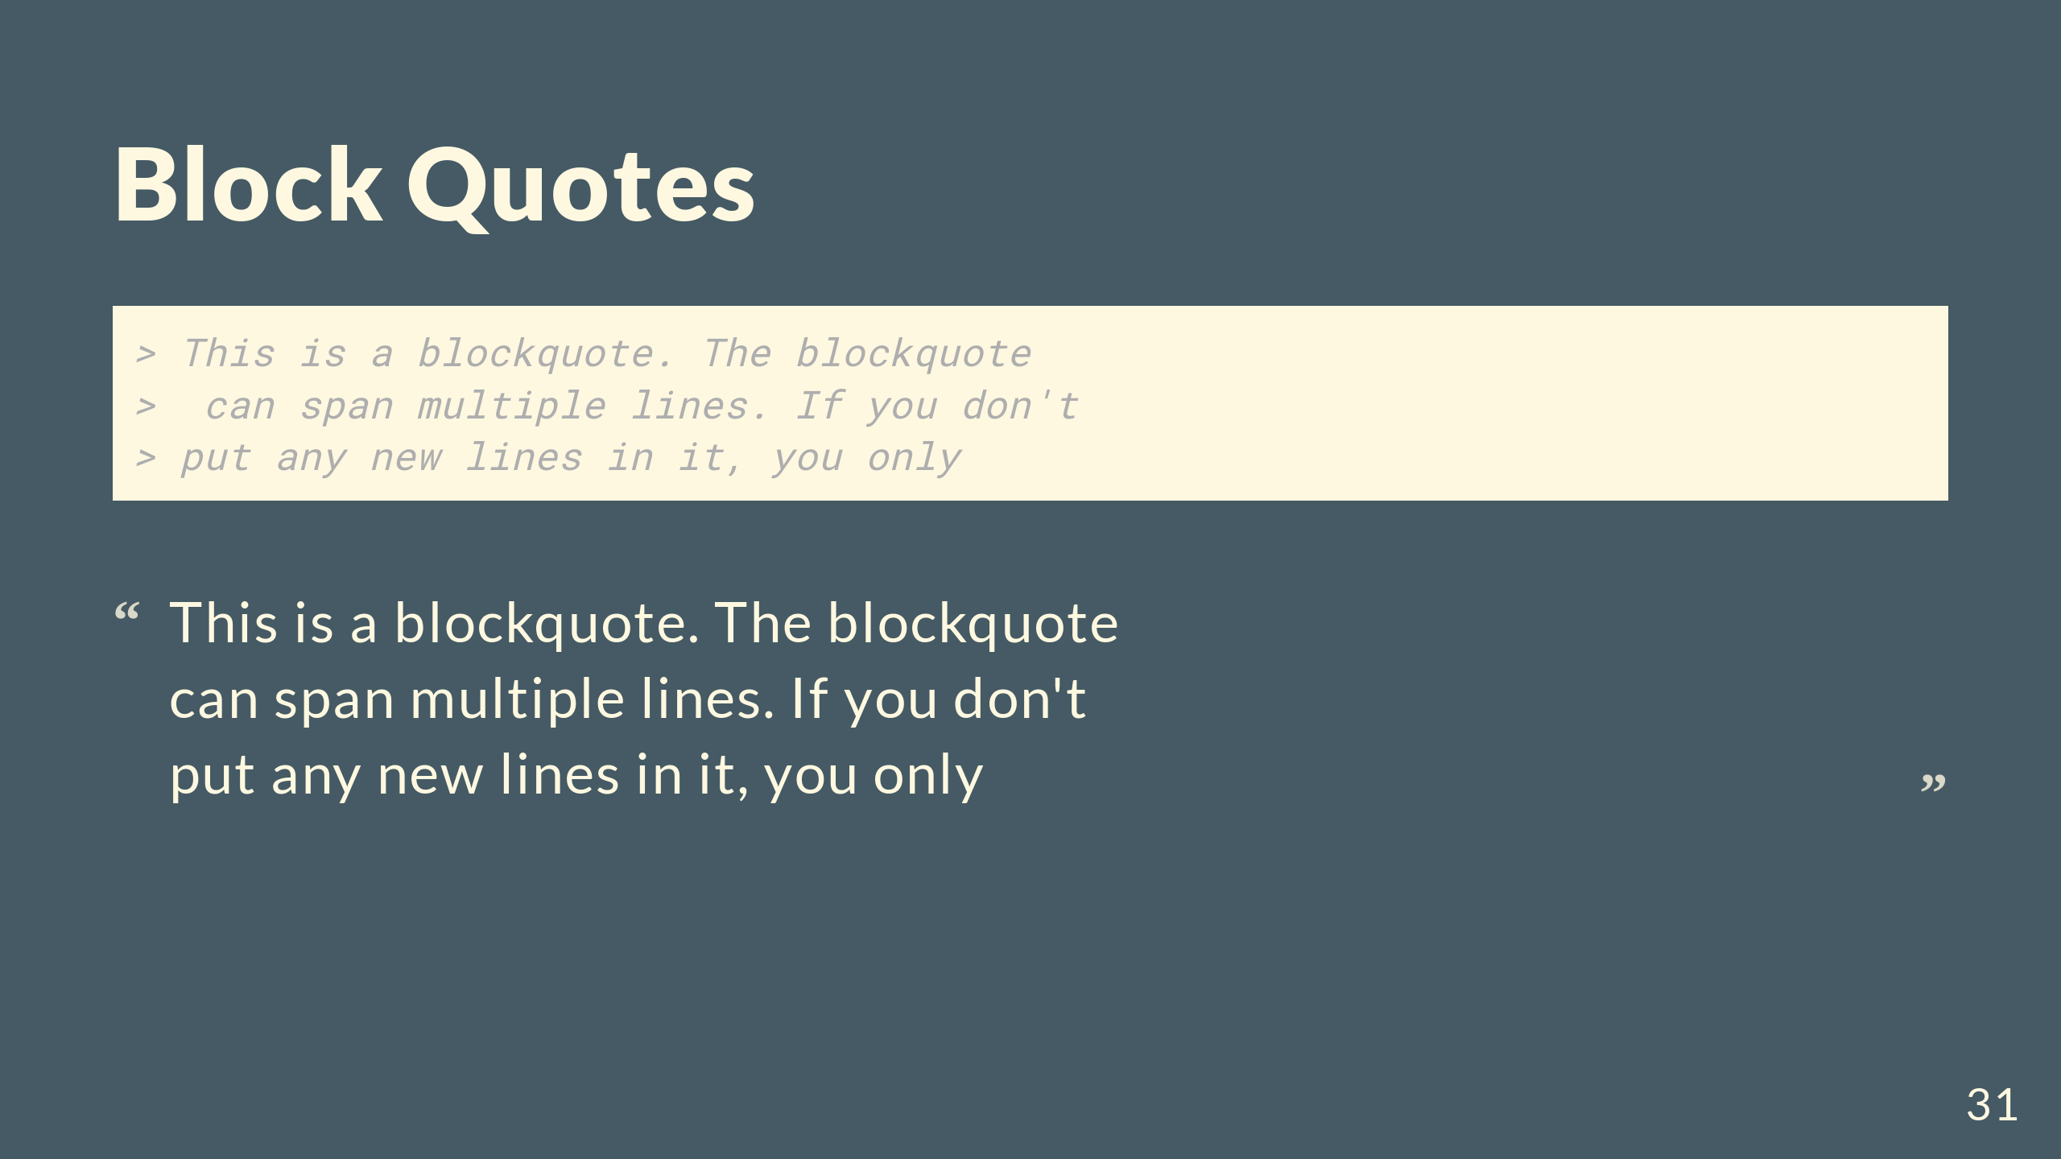

Slide 32
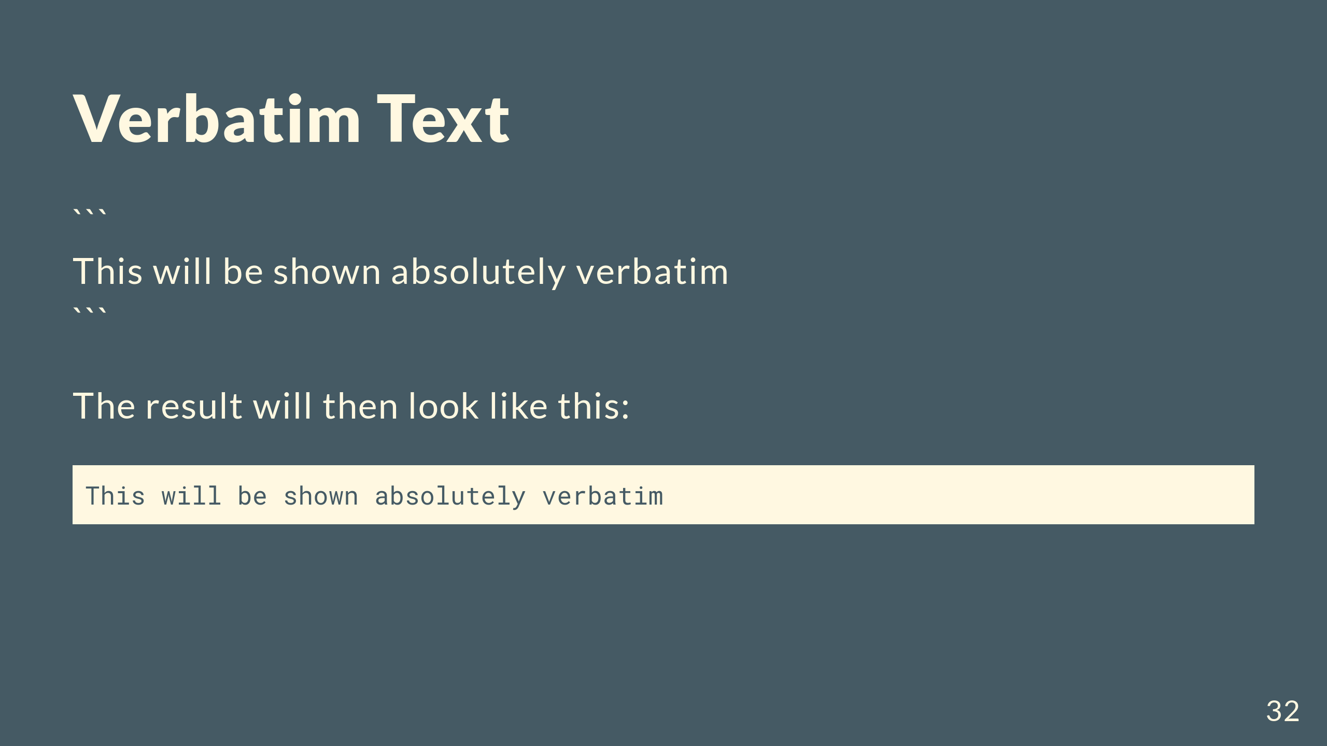

Slide 33


Slide 34
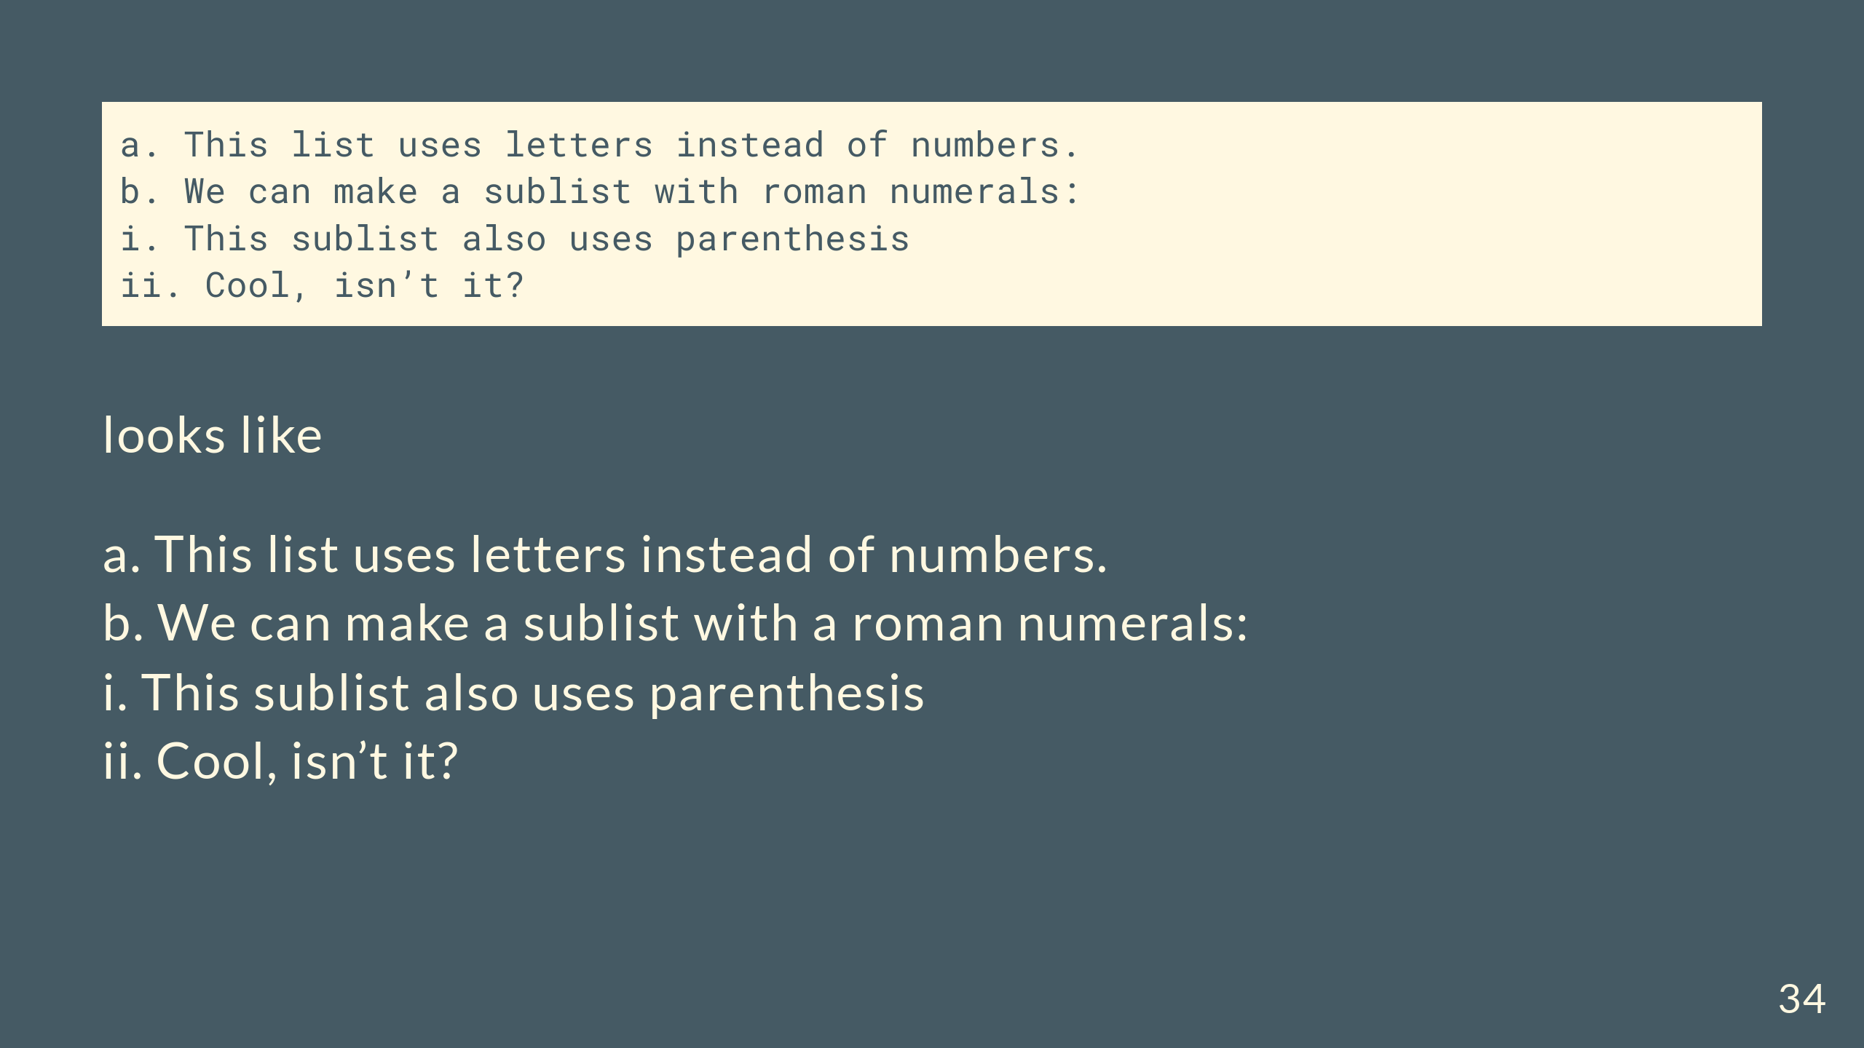

Slide 35
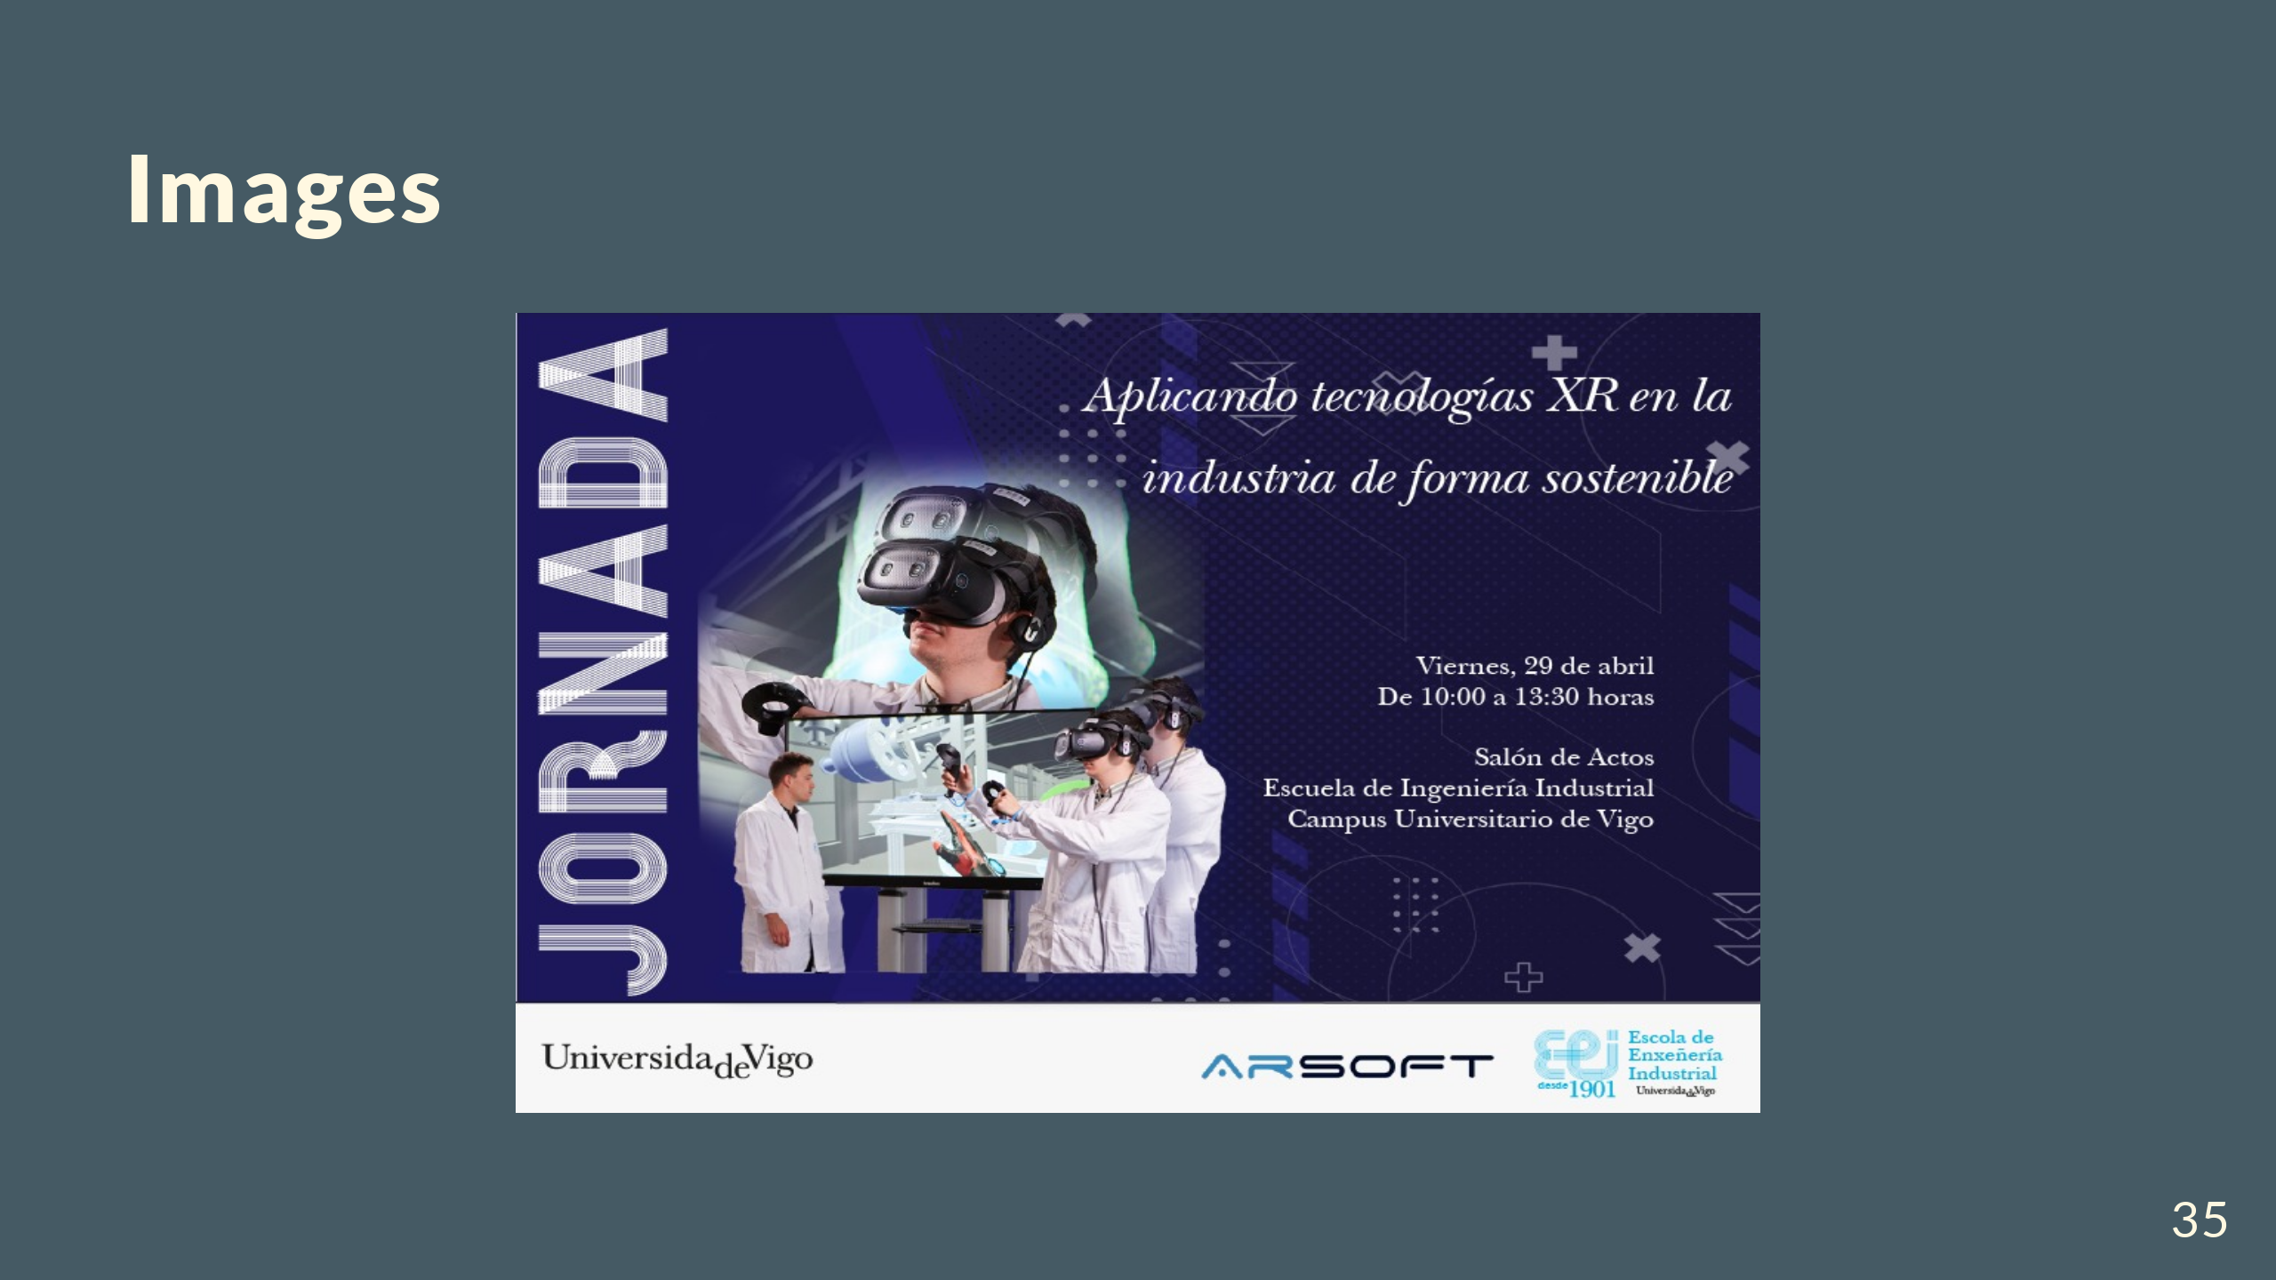

Slide 36


Slide 37
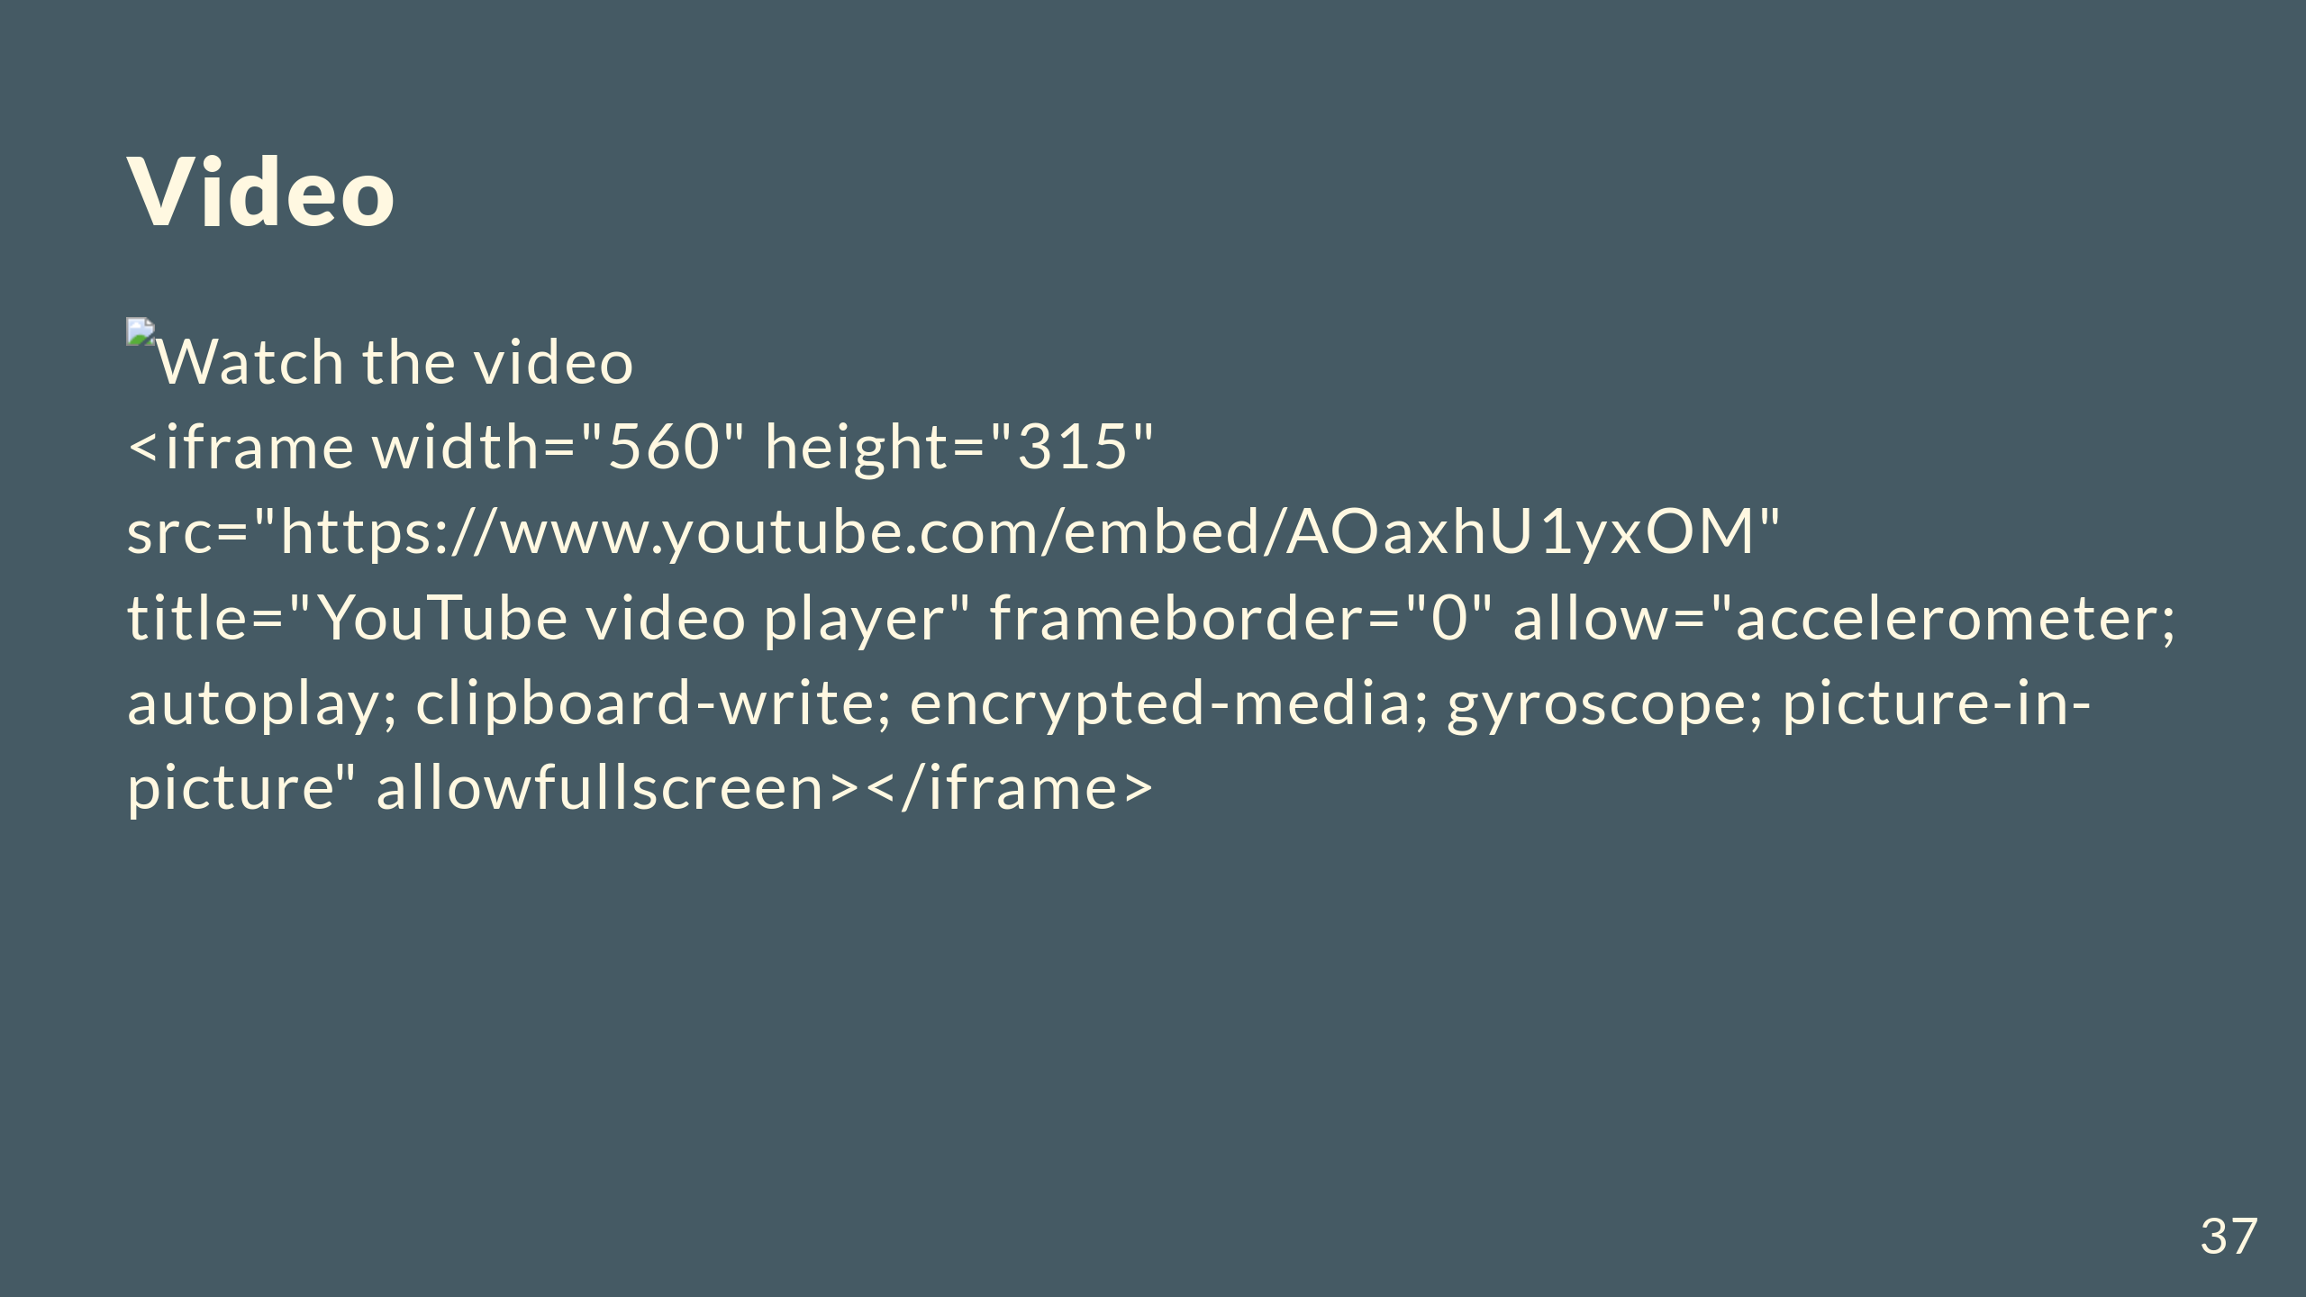

Slide 38
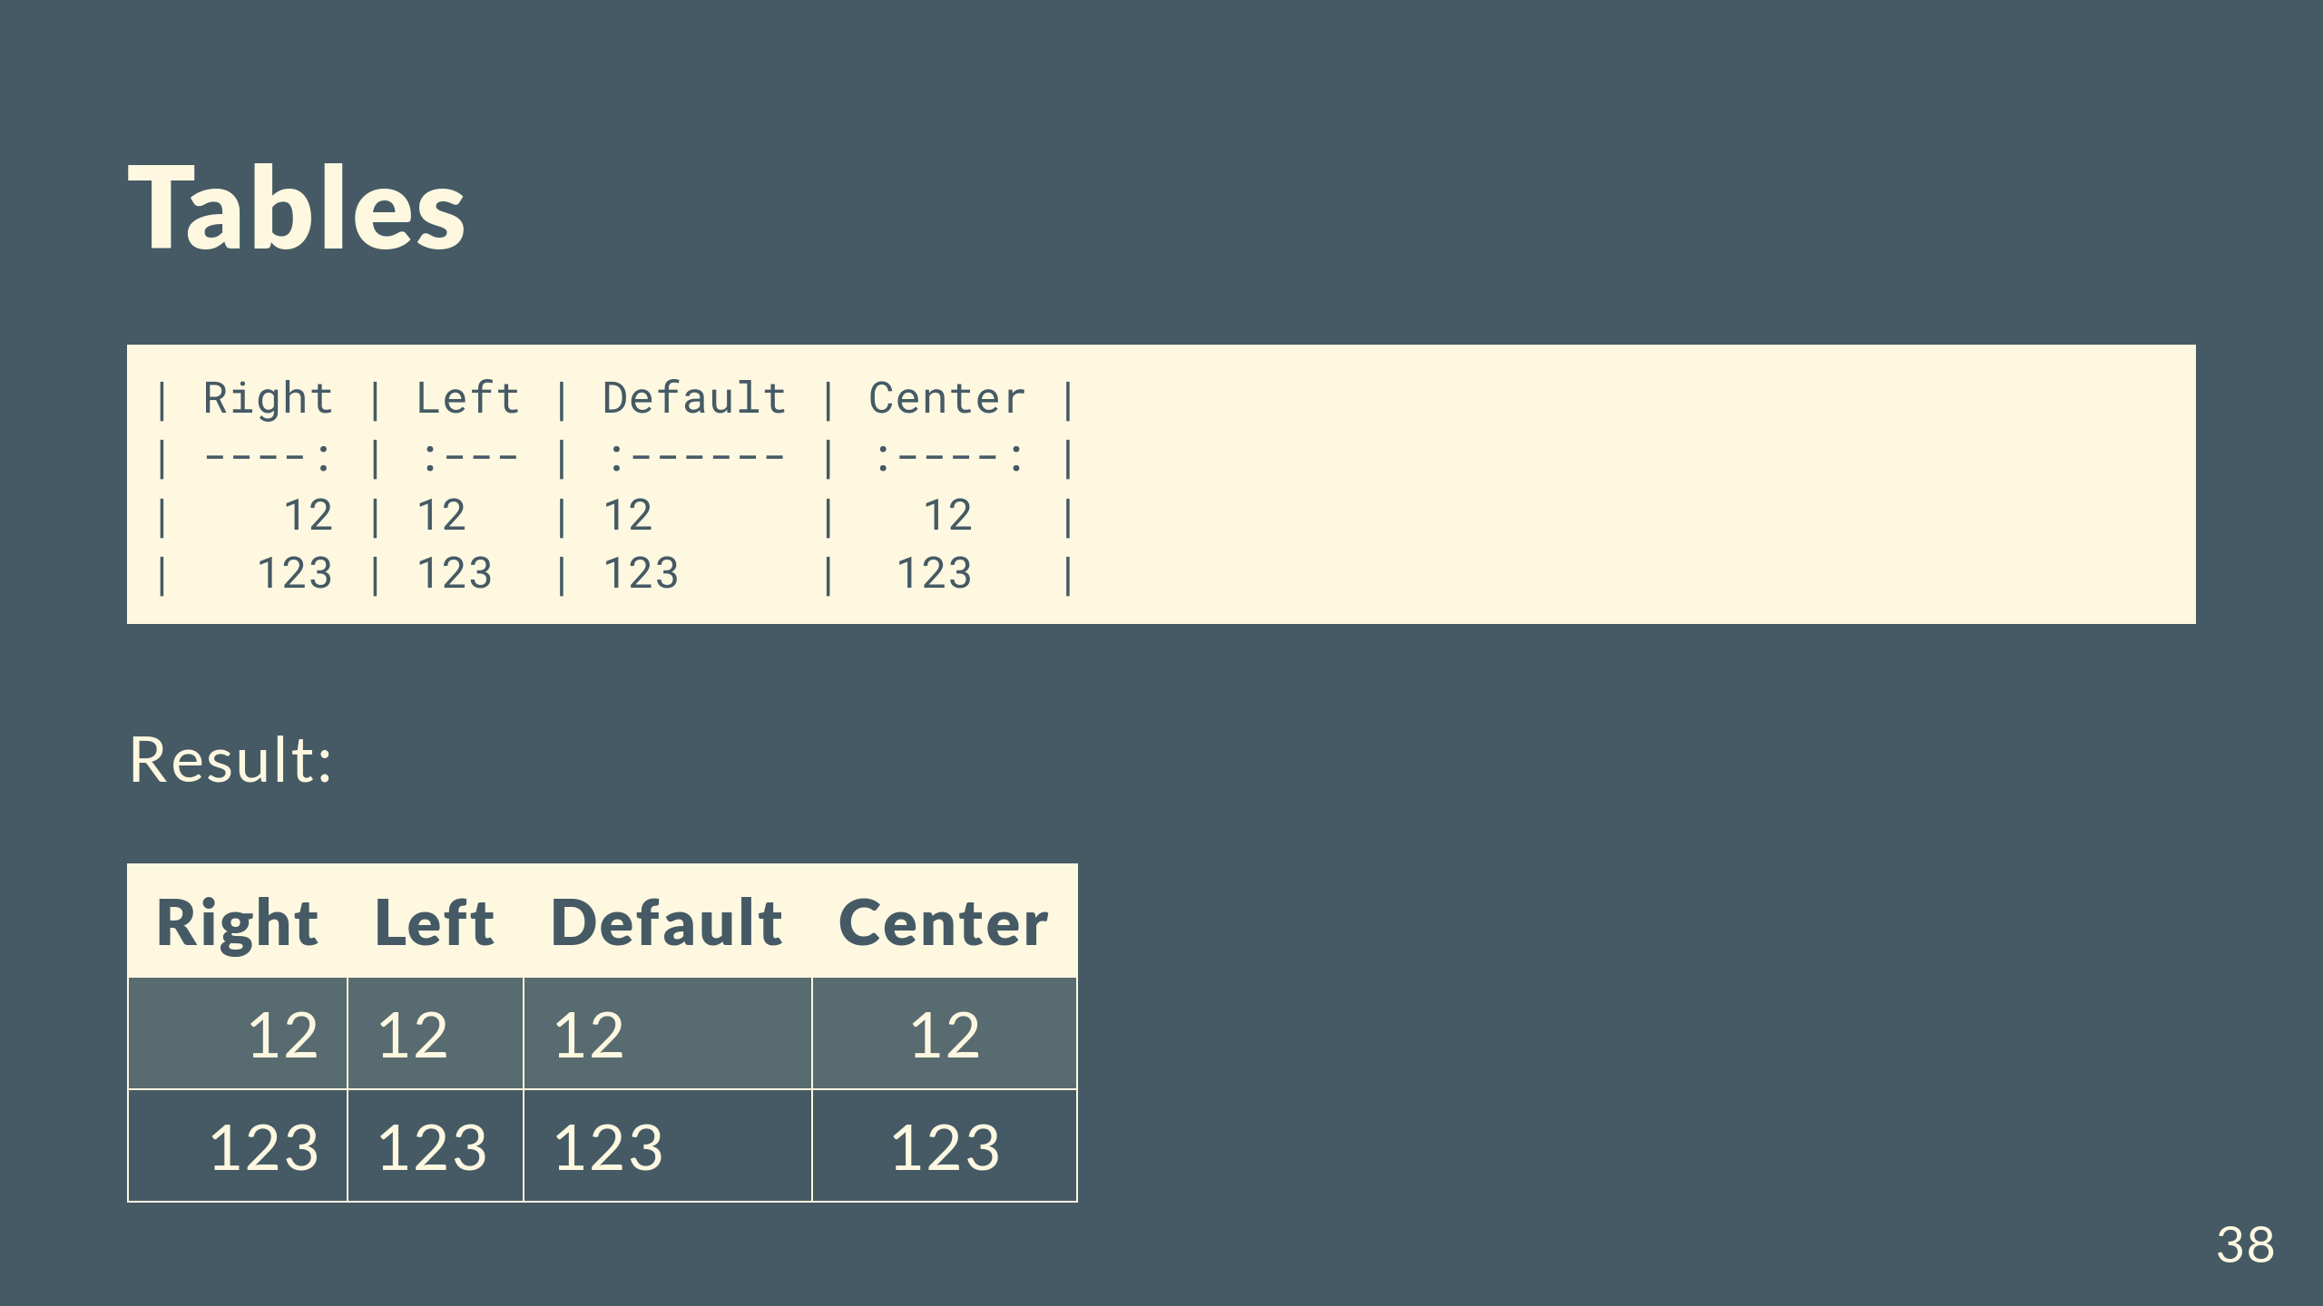

Slide 39
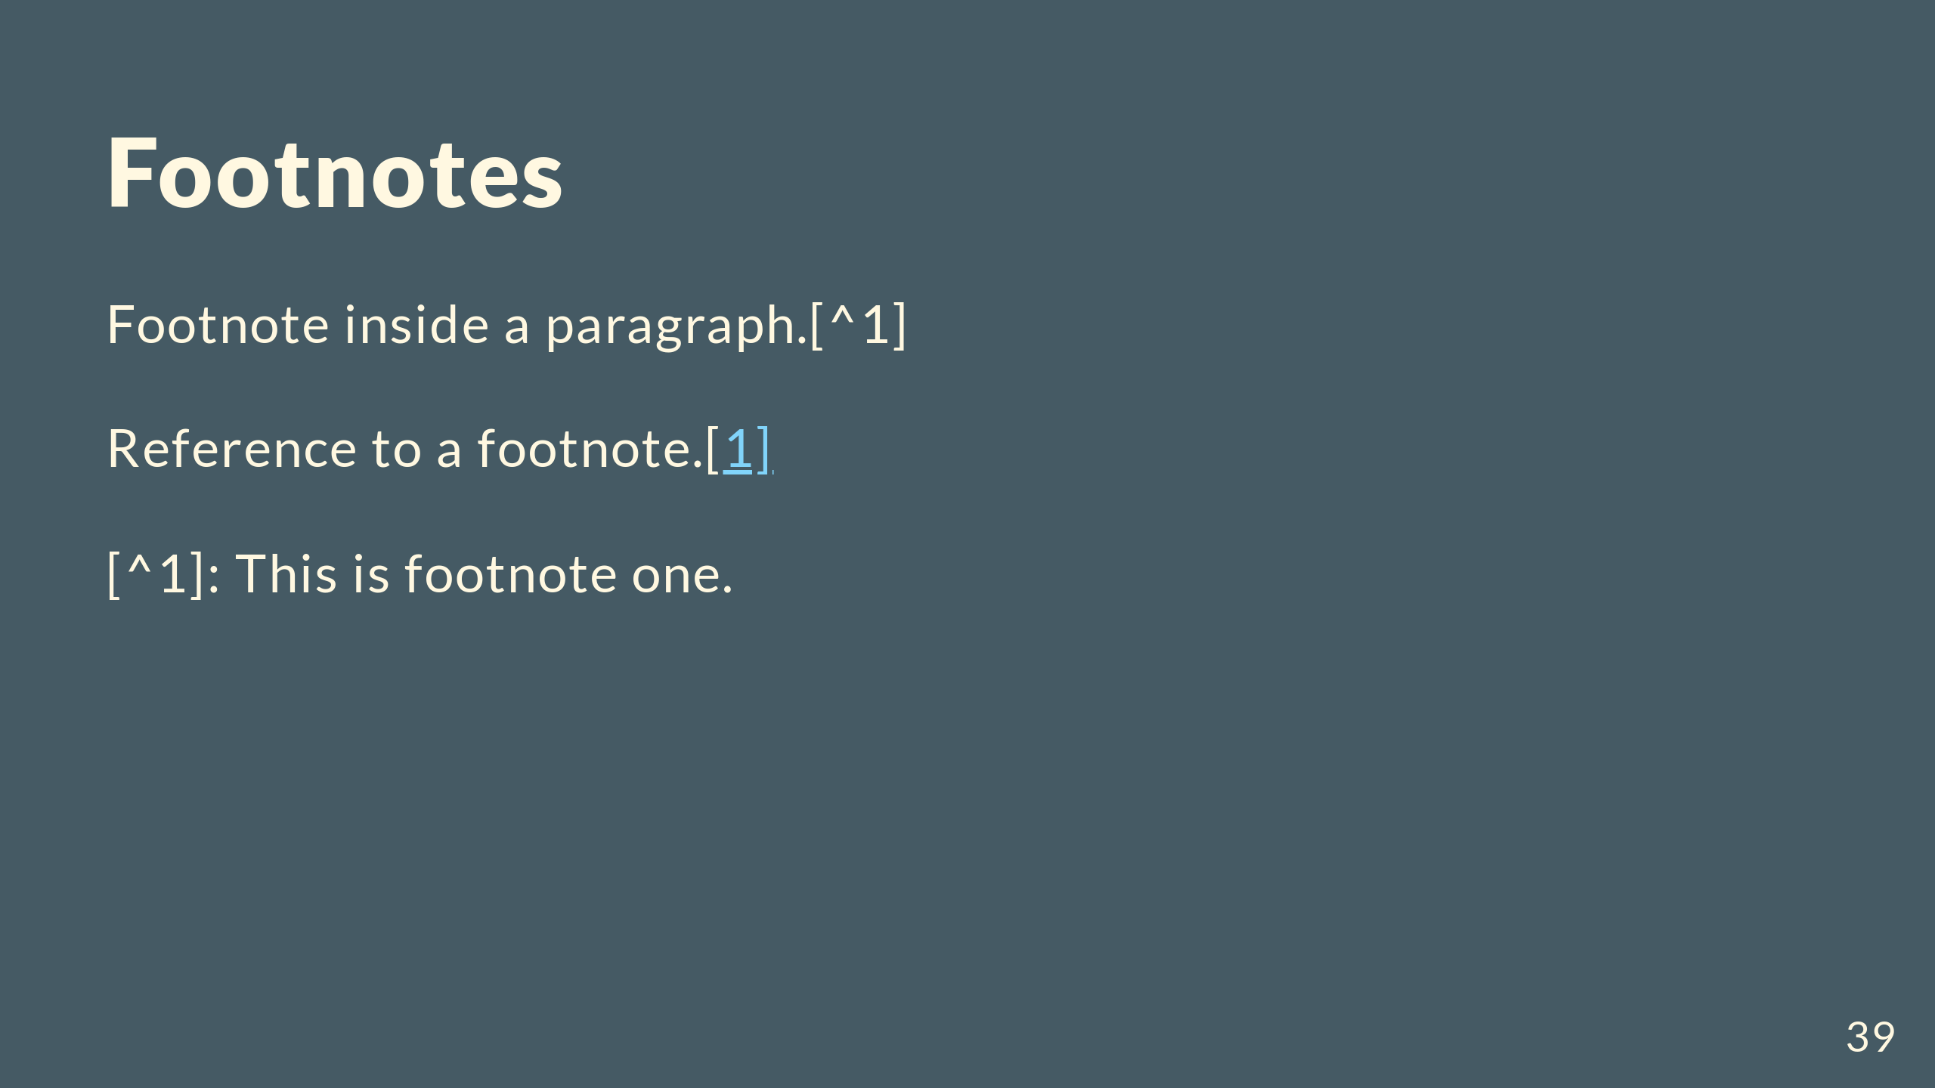

Slide 40
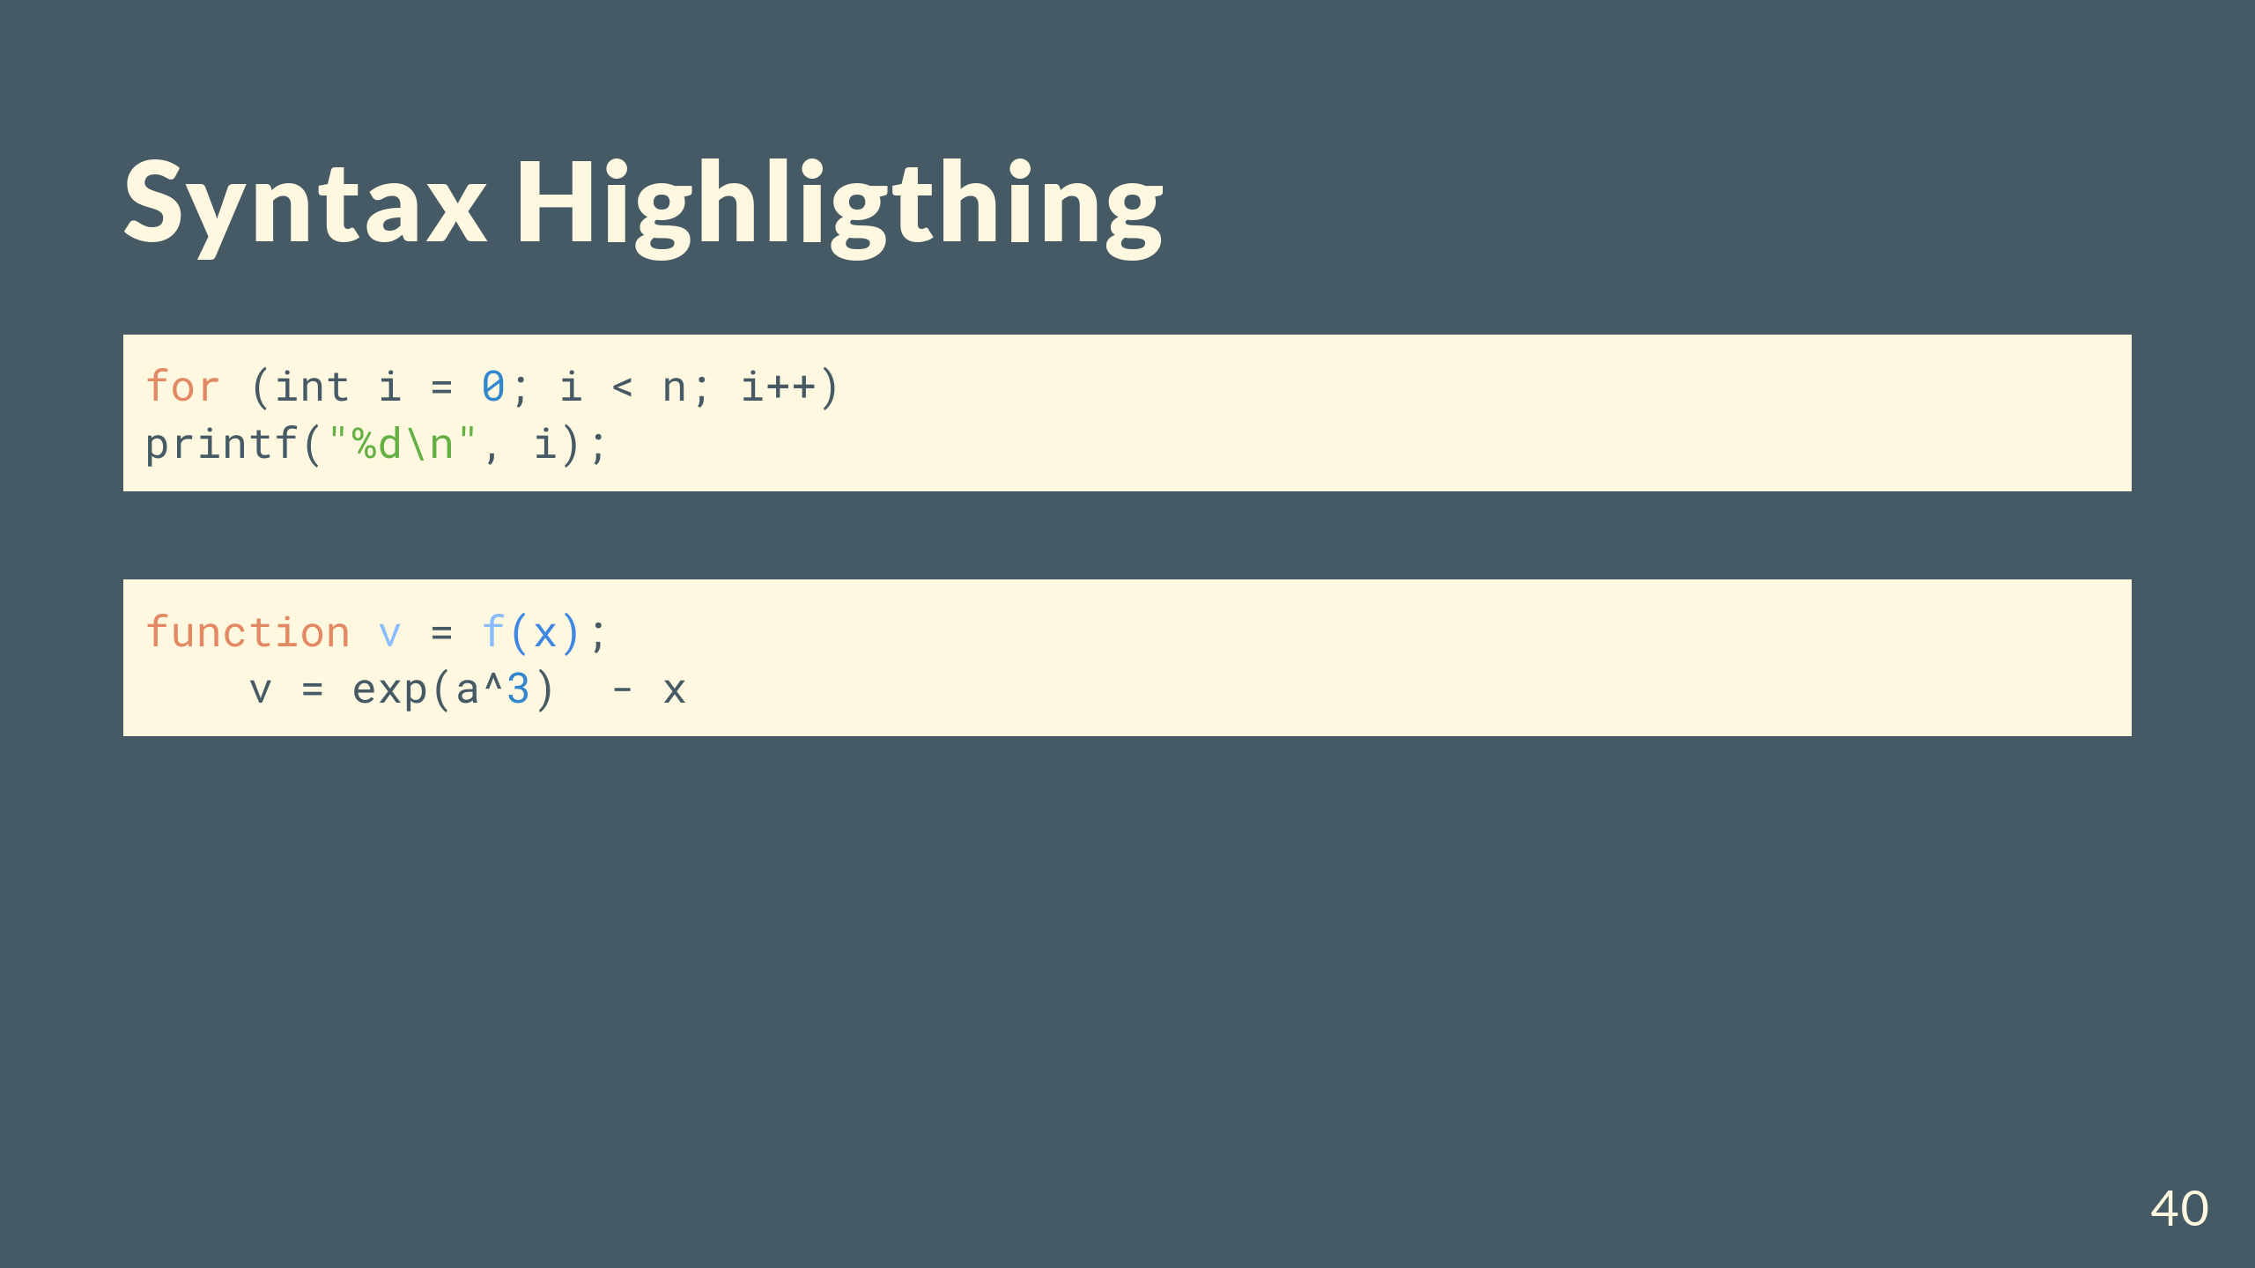

Slide 41
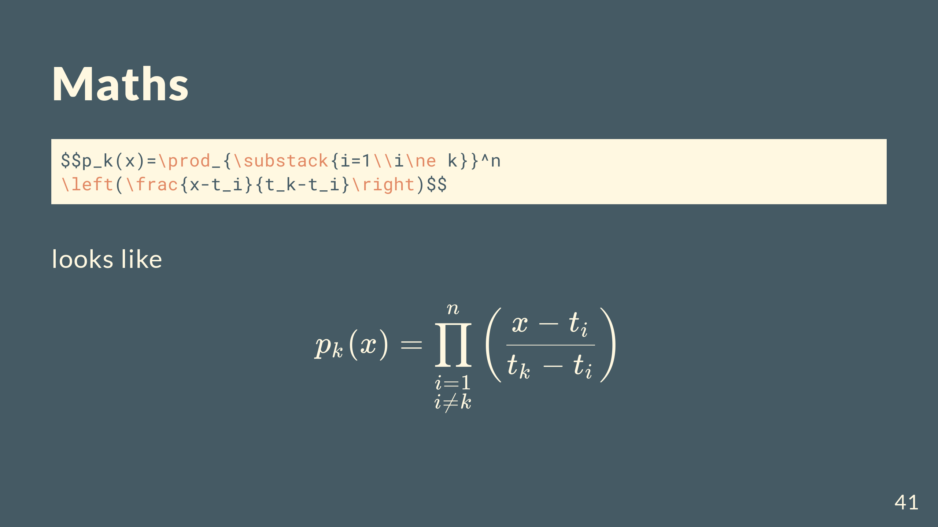

Slide 42
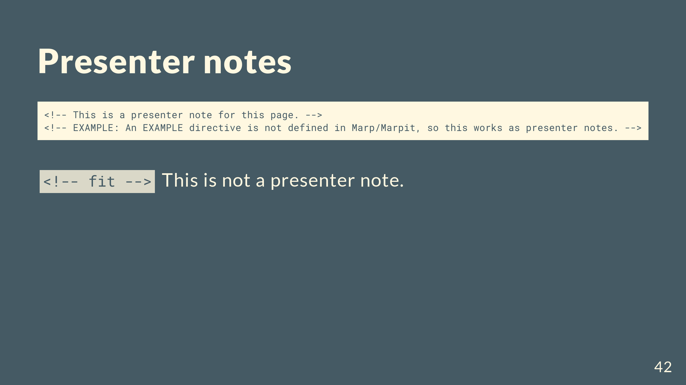

Slide 43
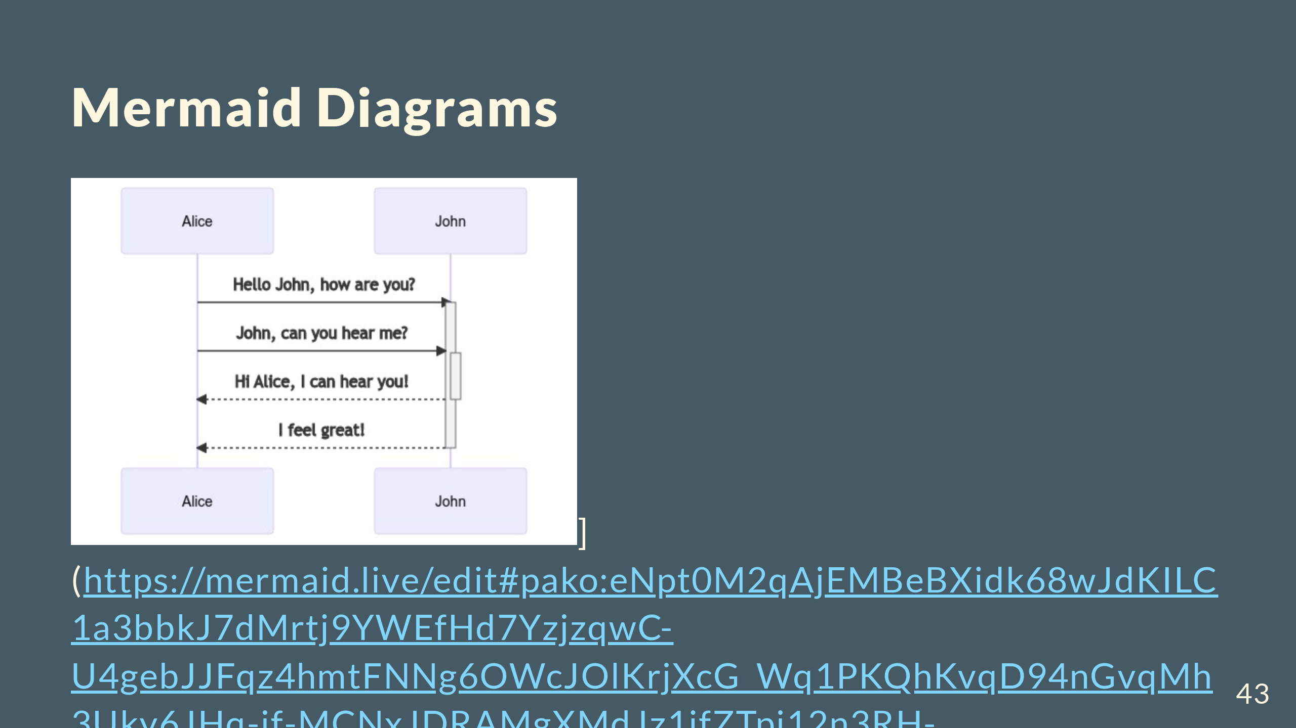

Slide 44
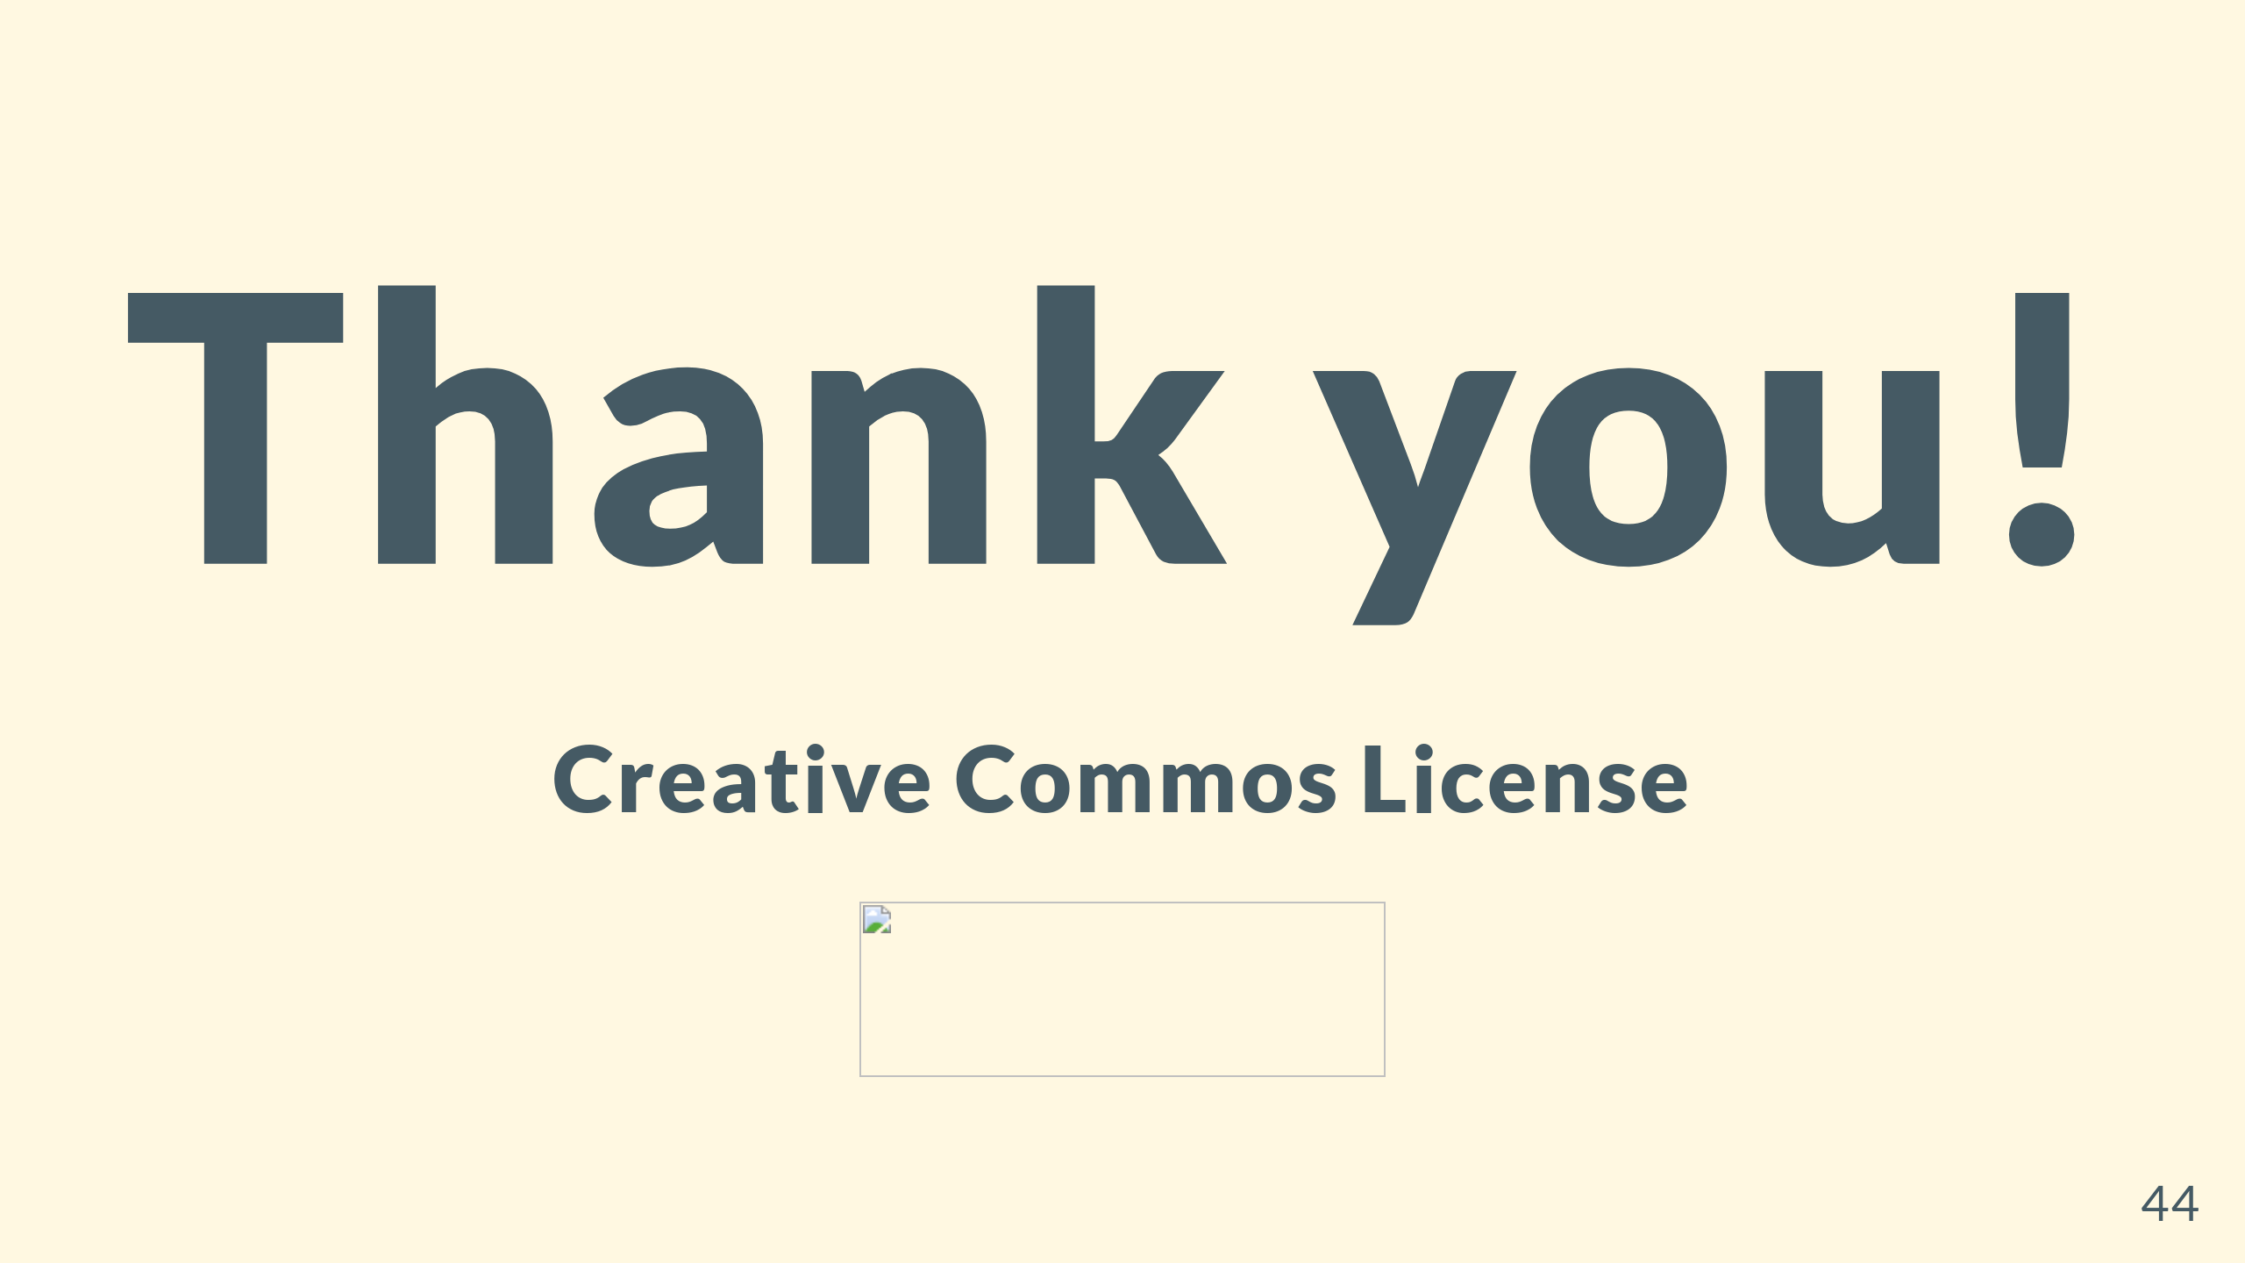

Slide 45


